Slide 1
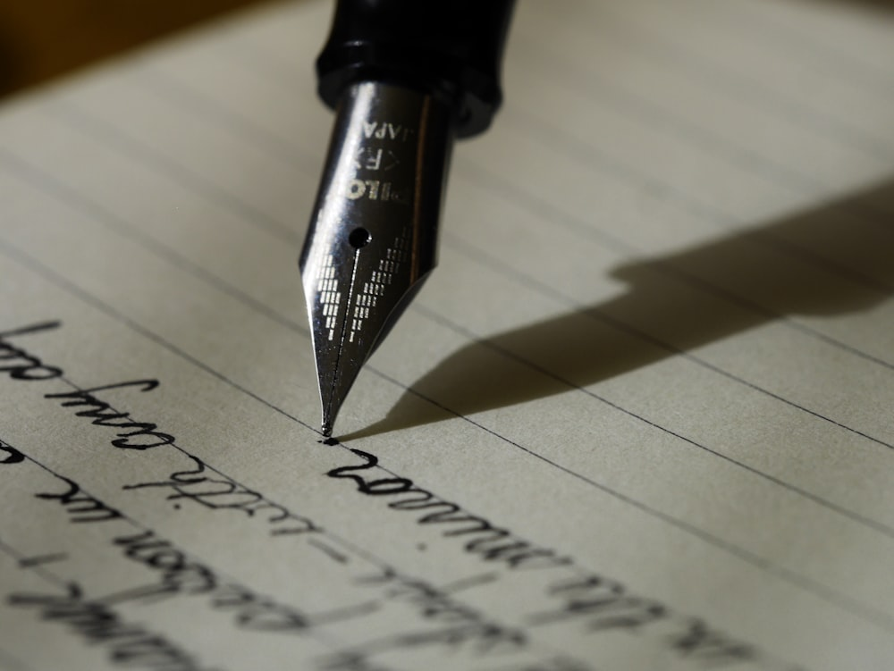
PERSONAL TIME CAPSULE
Writing a letter to yourself in the future

Slide 2
A Personal Time Capsule is a letter you write to your future self where you talk about the facts of your life, thoughts and dreams about the present, and your hopes for the future.

Slide 3
Writing a letter to your future self is like creating a time capsule of your thoughts, dreams, and the life journey you are on.

Slide 4
You can fill it with facts of where your life is now and all the hopes you have for the future.
You will show your letter to your teacher for evaluation and it will then be sealed in a self-addressed envelope and kept for the future.

Slide 5
It will be mailed to you one year later Privacy is very important—this letter is for your eyes only.

Slide 6
The letter you write to your future self should be dated and will you will address four topics about yourself:
Who am I?
What is life like right now where I live?
What have I learned in the past year?
What do I hope and wish for in the future?

Slide 7
Topic One: Who am I? How would I describe myself?
What/who are my:
Hobbies
Likes and dislikes (movies,
music, books, activities)
Joys and frustrations
Extracurricular activities
Hopes and dreams
Best friends
Pets
Crushes

Slide 8
Topic Two: What is life like right now where I live? (the world as well as my community and school)
Major current events (weather catastrophes, wars, etc.)
Current trends in media, technology, clothing, and style
Current pop icons, athletic stars, trendsetters, leaders, influencers
Descriptions of your community, school, and neighborhood
Favorite things to do with friends or places to hang out

Slide 9
Topic Three: What have I learned in the past year? (The lessons may have come from school, family, friends, and experiences.)
What is the best thing that happened to me in the past year?
Is there something funny, embarrassing, or exciting I want to remember to laugh about in the future?
Have I learned--any important lessons I do not want to forget?
What do I wish you could redo?
Do I have anything I am working on (fears, challenges, goals, mastering a skill)?
What are my milestones or accomplishments this year? What am I still working on?

Slide 10
Topic Four: What do I hope and wish for in the future?
What are my:
Goals for the future
Pieces of advice for myself in the future?
New habits I want to start
Things I want to exclude or add in my life
Predictions for the future
Things I am dreading; things I am looking forward to

Slide 11
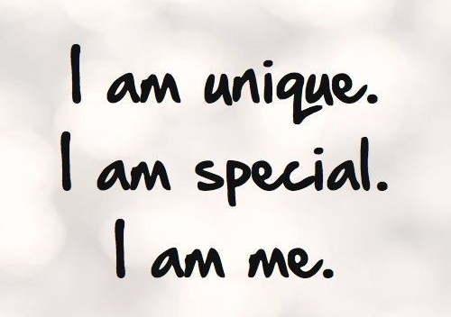
Since this is a very personal assignment for you, why not include :
Visuals
Drawings
Photos
Clip art
Concert or movie ticket stubs
Programs
Cards
Newspaper clippings
This is your special message to yourself!

Slide 12
Address an envelope to yourself so that your personal time capsule letter can be mailed back to you in one year.

Slide 13
Personal time capsules are a special way to preserve memories and feelings.
They are a tool to use our joys, fears, triumphs, and failures from the past to put our present into perspective.
They help remind us that the future is as bright as we choose to make it.

