Slide 1
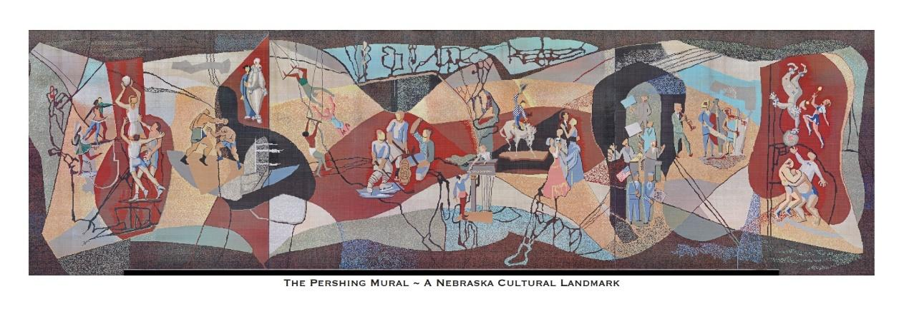
PERSHING MURAL PROJECT CURRICULUM
Learning From the Past, Understanding the Present,
and Discovering the Future
PUBLIC ART

Slide 2
Lesson #1

Slide 3
Nebraska Standards Addressed:
Create: FA 8.2.1.a Investigate ideas and materials (glossary) to demonstrate planning and refining.
Connect: FA 8.2.4.d Explain how images and objects are used to convey a story, familiar experience, or connection to the world.
Present: FA 8.2.2.c Explore how the meaning of art can be affected by the presentation mode or venue (glossary) (e.g., reproduction, digital, social media (glossary), or original museum/gallery experience).
Respond: FA 8.2.3.d Explain why a work of art can evoke different interpretations and how artwork is interpreted and evaluated by the way it is displayed or presented.
Notes:
Highlighted section represents what is covered in this lesson.

Slide 4
Objectives:
The student will know the characteristics of public art.
The student will understand the variables considered when presenting public art.
The student will be able to explore public art in relation to their own community.
Notes:
Highlighted section represents what is covered in this lesson.

Slide 5
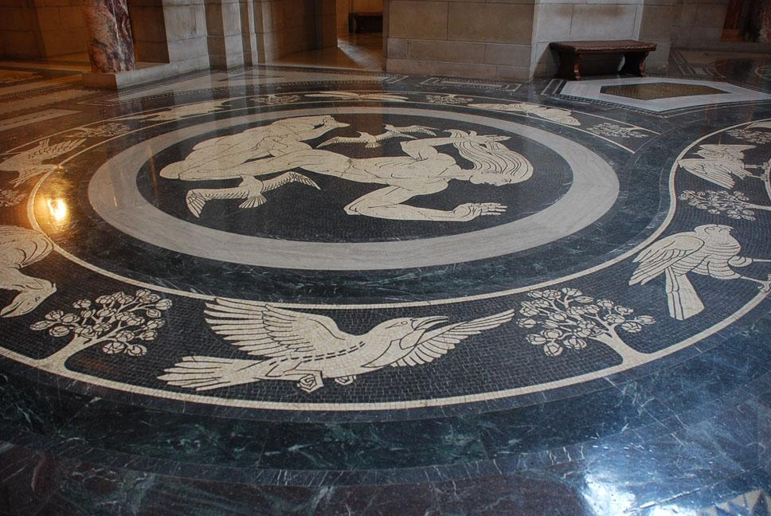
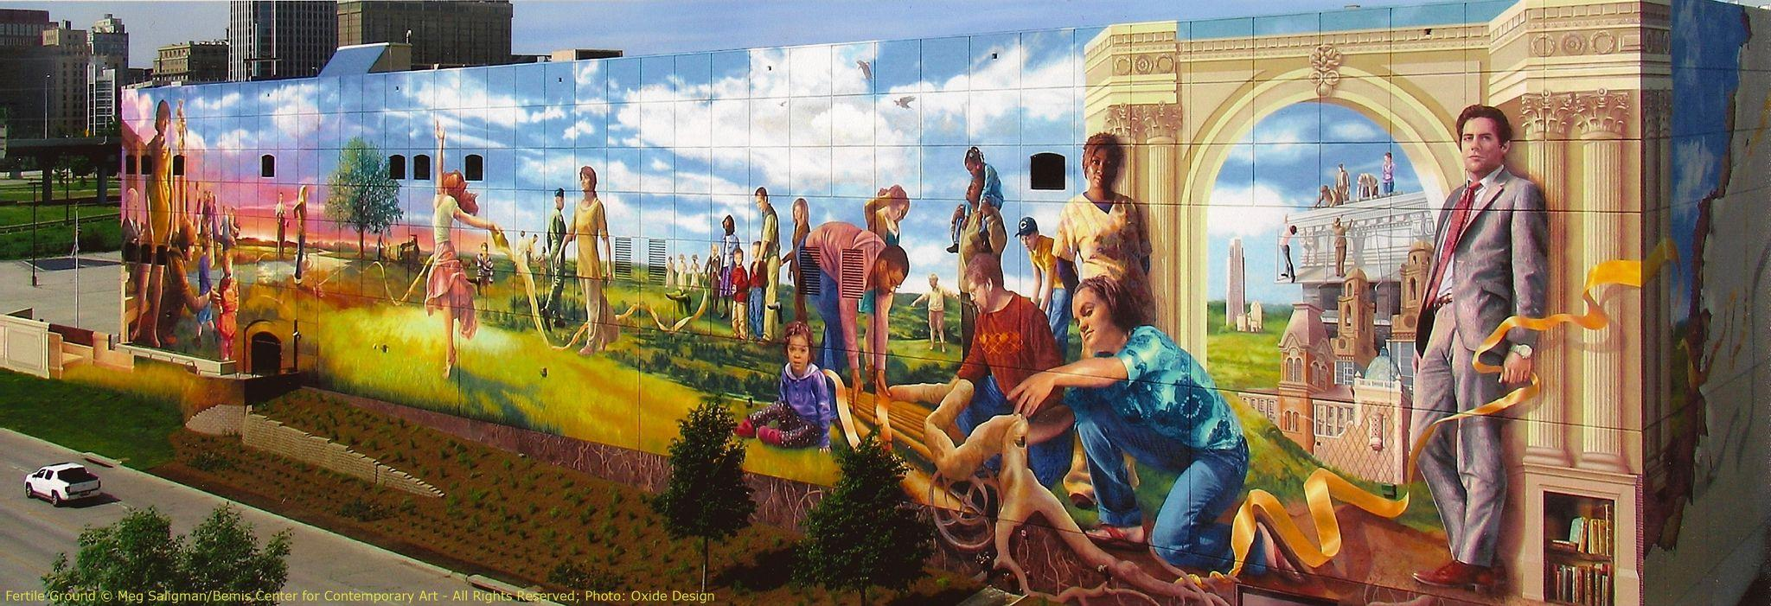
What do these artworks have in common?
1
What story or message does each work convey?
2
Connect: FA 8.2.4.d
Notes:
1 Capitol Rotunda Mosaic, Free Use Image with permission from the Office of the Capitol Commission.
2 Fertile Ground image, printed with permission from the artist, February 2024.

Slide 6
What do these artworks have in common?
1
-Mosaics
-Both in Lincoln
-At the capitol
-Available during business hours
-Smaller in scale
-Black/white
-Free standing
-Located outside at Wyuka
-Large mosaic
-Depict human form
-Each tells a story
-Large scale murals
-Available 24/7/365
-In color
What story or message does each work convey?
-Painting
-Located in Omaha
2
Notes:
This slide provides some possible answers. Answers not limited to these options.
1 https://nebraskacapitolart.com/art/genius-of-creative-energy/
2 https://www.onlyinyourstate.com/nebraska/fertile-ground-mural-ne/

Slide 7
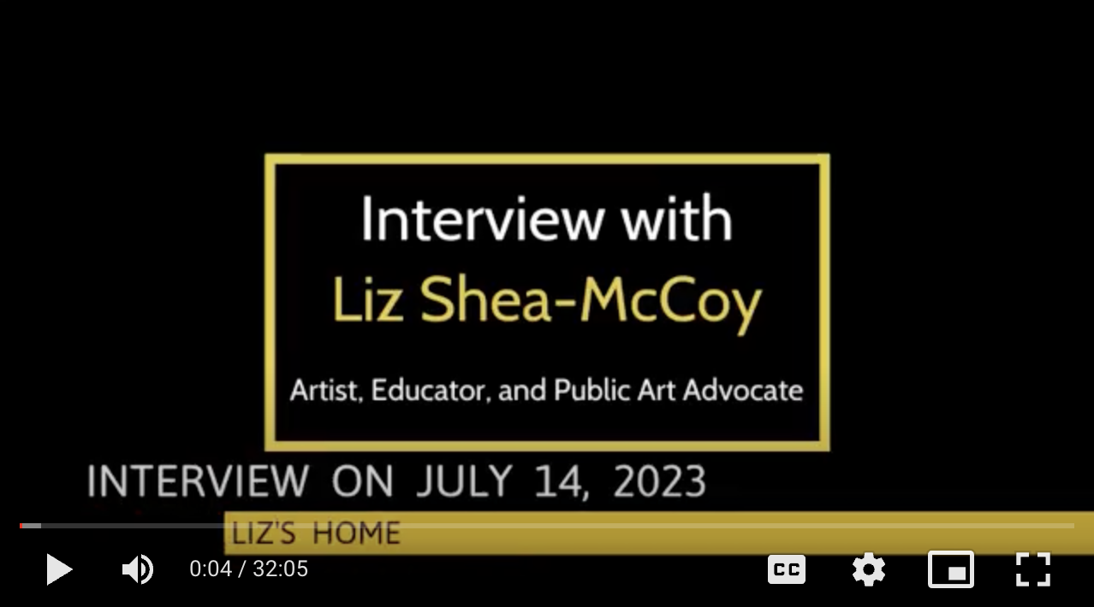
Liz Shea-McCoy of Lincoln is an educator and public art advocate having coordinated several public art projects including the saving and restoration of the Pershing Mural. Educator Bob Reeker of Lincoln interviewed Liz in July 2023.
As you watch the first 8 minutes of the video, note the significant projects that Liz has coordinated. Be prepared to share with a partner.
Notes:
Suggested to watch each of the four sections during different parts of the unit.
1. Tell us briefly about the different public art projects you've coordinated over the years. Starts :42.
2. What has been the most meaningful in working with public art? Starts 8:09.
3. What are you currently working on in public art? Starts 19:12.
4. What advice would you give about those pursuing public art? Starts 25:40.

Slide 8
What is public art?
Common characteristics may include:
Public accessibility/availability
Public location placement
Community involvement/interaction including funding
Works can be permanent or temporary
Others?
The student will know the characteristics of public art.

Slide 9
Closure:
Looking at the characteristics of public art, do you think that art we find in a museum or gallery is considered public art? Why?

Slide 10
Lesson #2

Slide 11
Nebraska Standards Addressed:
Create: FA 8.2.1.a Investigate ideas and materials (glossary) to demonstrate planning and refining.
Connect: FA 8.2.4.d Explain how images and objects are used to convey a story, familiar experience, or connection to the world.
Present: FA 8.2.2.c Explore how the meaning of art can be affected by the presentation mode or venue (glossary) (e.g., reproduction, digital, social media (glossary), or original museum/gallery experience).
Respond: FA 8.2.3.d Explain why a work of art can evoke different interpretations and how artwork is interpreted and evaluated by the way it is displayed or presented.
Notes:
Highlighted section represents what is covered in this lesson.

Slide 12
Objectives:
The student will know the characteristics of public art.
The student will understand the variables considered when presenting public art.
The student will be able to explore public art in relation to their own community.

Slide 13
We will continue with the interview with Liz about public art. As you watch the next section, note that Liz talks about artist autonomy. Be prepared to share with others what that means to you.
Notes:
Suggested to watch each of the four sections during different parts of the unit.
1. Tell us briefly about the different public art projects you've coordinated over the years. Starts :42.
2. What has been the most meaningful in working with public art? Starts 8:09.
3. What are you currently working on in public art? Starts 19:12.
4. What advice would you give about those pursuing public art? Starts 25:40.

Slide 14
What is the purpose or goal of public art?
What does public art say about a community?
In what ways does public art serve social, civic, and even political purposes?
Respond: FA 8.2.3.d
Notes:
Notes to consider while supporting student discussion.
There are some core and important questions when it comes to who gets to create public art, cost, etc. Formal public art has historically been dominated (and still is, oftentimes) by more affluent communities. And, importantly, public art of a variety of types, particularly muralism, has become a key part of urban gentrification projects. For example, while the Pershing mural was saved, there are many times more stories of amazing architecture and public art in older, less affluent neighborhoods that were not saved, but destroyed.

Slide 15
With your thoughts about artist autonomy or voice, how might what the artist expresses or personally connects to, impact how the viewer interprets the work? Is there a connection between artist autonomy and viewer interpretation?
Respond: FA 8.2.3.d

Slide 16
An alternate activity for slide #15.
Create two columns as outlined on the right.
List as many components on the two topics as possible.
Draw lines between those that are in common.
Write a summary of your observations at the bottom.
Artist autonomy
Viewer interpretation
1.
2.
3.
4.
5.
6.
…
1.
2.
3.
4.
5.
6.
…
Summary:
Respond: FA 8.2.3.d

Slide 17
Closure:
After reflecting on artist autonomy and viewer interpretation, do you believe one is more important than the other? Why?

Slide 18
Lesson #3

Slide 19
Nebraska Standards Addressed:
Create: FA 8.2.1.a Investigate ideas and materials (glossary) to demonstrate planning and refining.
Connect: FA 8.2.4.d Explain how images and objects are used to convey a story, familiar experience, or connection to the world.
Present: FA 8.2.2.c Explore how the meaning of art can be affected by the presentation mode or venue (glossary) (e.g., reproduction, digital, social media (glossary), or original museum/gallery experience).
Respond: FA 8.2.3.d Explain why a work of art can evoke different interpretations and how artwork is interpreted and evaluated by the way it is displayed or presented.
Notes:
Highlighted section represents what is covered in this lesson.

Slide 20
Objectives:
The student will know the characteristics of public art.
The student will understand the variables considered when presenting public art.
The student will be able to explore public art in relation to their own community.

Slide 21
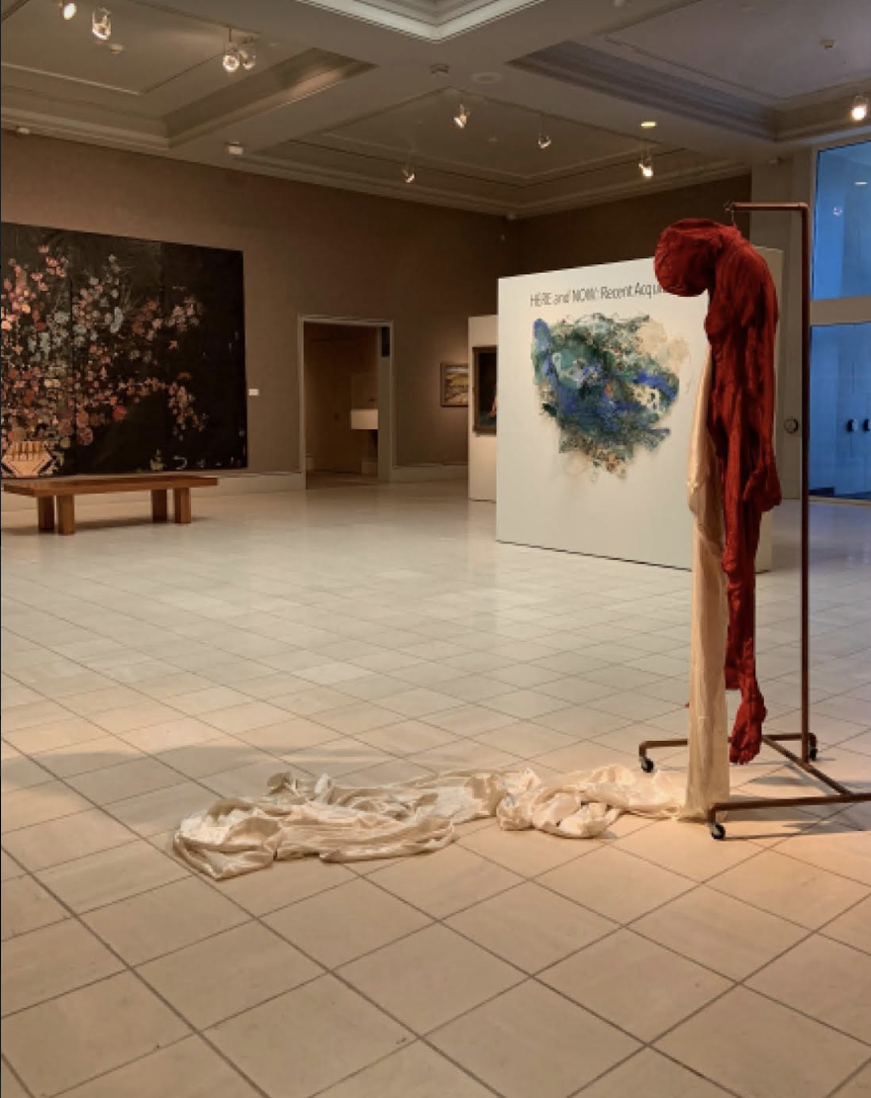
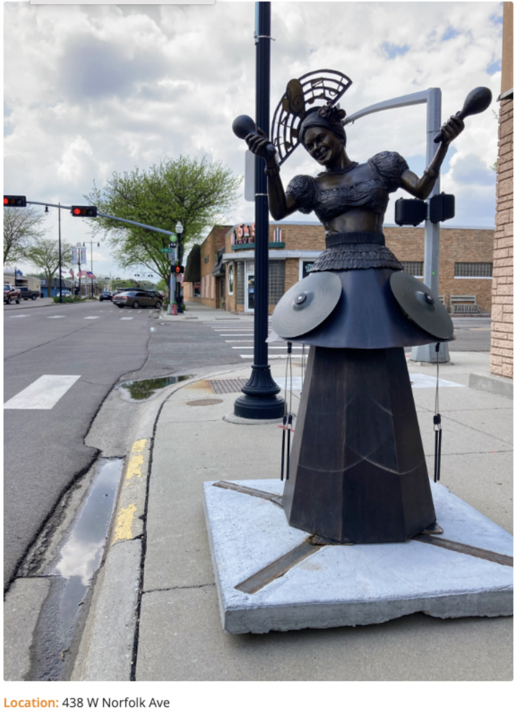
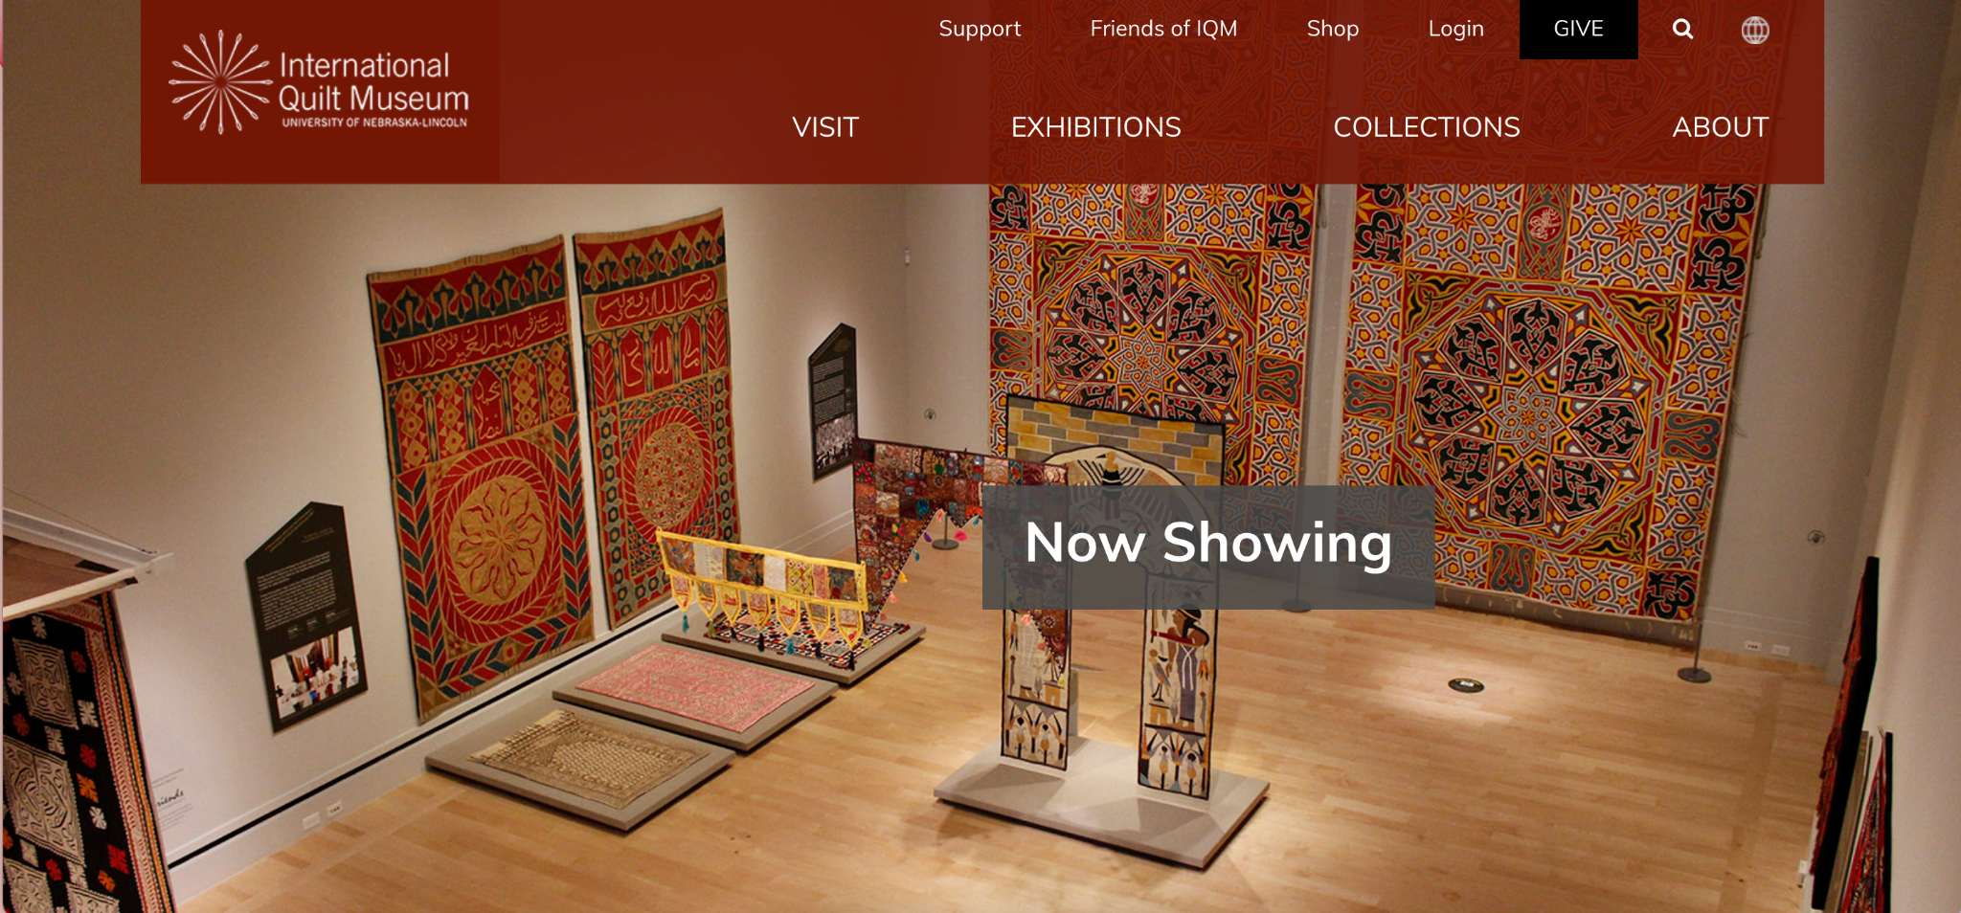
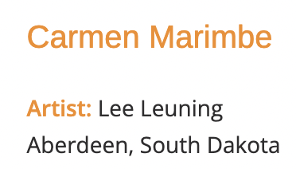
Below are three works of art.
Reflect on and then share with others the venue location and how that placement might impact the creation and/or viewing of the work.
2
3
1
Norfolk, Nebraska
Kearney, Nebraska
Present: FA 8.2.2.c
Notes:
1 MONA Gallery, Image, printed with permission from Museum of Nebraska Art, February 2024. MUSEUM GALLERY
2 Sculpture by Lee Leuning, printed with permission from the artist, February 2024. OUTDOORS PUBLIC ART
3 International Quilt Museum website, printed with permission from IQM, February 2024. (https://www.internationalquiltmuseum.org/) ONLINE

Slide 22
We will continue with the interview with Liz about public art. Liz shares about her latest public art project - the saving, restorating, and presenting of the Pershing Mural which was on the front of Pershing Auditorium from 1957-2023.
Why might this public art project be so significant to Nebraskans?
Notes:
Suggested to watch each of the four sections during different parts of the unit.
1. Tell us briefly about the different public art projects you've coordinated over the years. Starts :42.
2. What has been the most meaningful in working with public art? Starts 8:09.
3. What are you currently working on in public art? Starts 19:12.
4. What advice would you give about those pursuing public art? Starts 25:40.

Slide 23
What variables must be considered when presenting public art?
Availability for viewing
Placement for accessibility
Security of art work
Durability due to weather
Safety for viewers
Others?
The student will understand the variables considered when presenting public art.

Slide 24
What if…
…you removed one of the considerations? How would that impact the presenting of public art?
Availability for viewing
Placement for accessibility
Security of art work
Durability due to weather
Safety for viewers
Others?
The student will understand the variables considered when presenting public art.

Slide 25
Another consideration with public art is funding.
How is public art paid for?
1) private donors
2) public dollars through arts programs.
Or, maybe a combination of the two.
How might the funding of a public art project impact who makes the art?
How might the message of the public art be affected by funding?
The student will understand the variables considered when presenting public art.
Notes:
Notes to consider when supporting student discussion.
Helping students think about how public arts are funded and then how that impacts what kinds of pubic art are made seems important. For example, as students conceptualize their own public art project, they could be asked to consider who might pay for this and what are the implications of different potential funding sources. A private donor, for example, might have their own interests in what the public art should look like, as in the Pershing mural. Public funding sometimes comes with similar parameters, but also often provides funding that does not come with the same strings as private funding. What makes a project attractive to funders? What kinds of important public art projects might struggle to find funding and why? How might a community work around some of the challenges associated with funding public art?

Slide 26
Closure:
How might the meaning of the artwork be impacted by the venue in which the art is exhibited?

Slide 27
Lesson #4
This lesson would likely involve several class sessions.

Slide 28
Nebraska Standards Addressed:
Create: FA 8.2.1.a Investigate ideas and materials (glossary) to demonstrate planning and refining.
Connect: FA 8.2.4.d Explain how images and objects are used to convey a story, familiar experience, or connection to the world.
Present: FA 8.2.2.c Explore how the meaning of art can be affected by the presentation mode or venue (glossary) (e.g., reproduction, digital, social media (glossary), or original museum/gallery experience).
Respond: FA 8.2.3.d Explain why a work of art can evoke different interpretations and how artwork is interpreted and evaluated by the way it is displayed or presented.
Notes:
Highlighted section represents what is covered in this lesson.

Slide 29
Objectives:
The student will know the characteristics of public art.
The student will understand the variables considered when presenting public art.
The student will be able to explore public art in relation to their own community.

Slide 30
We will finish with the interview with Liz about public art. Liz provides suggestions for anyone wanting to explore public art in their community.
What advice does Liz provide?
Notes:
Suggested to watch each of the four sections during different parts of the unit.
1. Tell us briefly about the different public art projects you've coordinated over the years. Starts :42.
2. What has been the most meaningful in working with public art? Starts 8:09.
3. What are you currently working on in public art? Starts 19:12.
4. What advice would you give about those pursuing public art? Starts 25:40.

Slide 31
Where do we find public art in our town, city, community?
Where are areas that are void of public art?
Why?
The student will be able to explore public art in relation to their own community.

Slide 32
Art Problem: Design and create a prototype for a public art piece for the community.
Research: What imagery might best represent the community?
Ideation: Develop a series of solution for public art.
Creation: Build a prototype using materials of choice, by teacher, student, or both.
Verification: How does the public art prototype solve the art problem? What did I learn from the unit? How does what I learned impact the future? (This concept will be explored further in lesson #5)
The student will be able to explore public art in relation to their own community.

Slide 33
Closure:
What part of your design do you feel is most successful?
Are there any areas to improve?
If you could rework this project, what would you change?

Slide 34
Lesson #5

Slide 35
Nebraska Standards Addressed:
Create: FA 8.2.1.a Investigate ideas and materials (glossary) to demonstrate planning and refining.
Connect: FA 8.2.4.d Explain how images and objects are used to convey a story, familiar experience, or connection to the world.
Present: FA 8.2.2.c Explore how the meaning of art can be affected by the presentation mode or venue (glossary) (e.g., reproduction, digital, social media (glossary), or original museum/gallery experience).
Respond: FA 8.2.3.d Explain why a work of art can evoke different interpretations and how artwork is interpreted and evaluated by the way it is displayed or presented.
Notes:
Highlighted section represents what is covered in this lesson.

Slide 36
Objectives:
The student will know the characteristics of public art.
The student will understand the variables considered when presenting public art.
The student will be able to explore public art in relation to their own community.

Slide 37
As we complete this unit about public art, we will use feedback and reflection to determine the impact on our learning.
Feedback - Partner and share your work with others. Give feedback on areas of success as well as needed suggestions.
Reflection - How does your artwork express an idea or story of public art in relation to your community? What did you learn? How does the learning impact your life now? How might this work support your experiences in the future?
The student will be able to explore public art in relation to their own community.

Slide 38
Closure:
Accessibility to public art is one of several characteristics to consider.
Presentation of public art, especially in Nebraska, has many consideration including safety and weather.
Public art belongs in every community including the learner’s community.

