Slide 1
Nebraska Sites on the National Register of Historic Places Scavenger Hunt

Slide 2
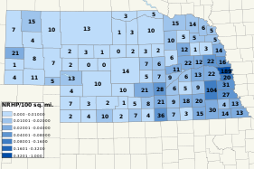
Nebraska Sites
Nebraska currently has over 1,000 properties throughout the state listed on the National Register of Historic Places.

Slide 3
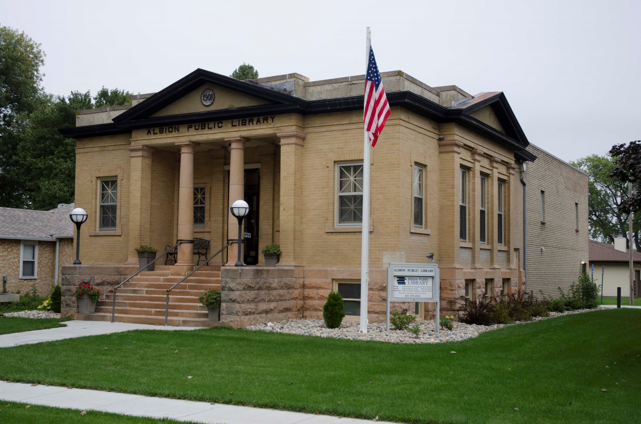
Albion Public Library
These properties range from city buildings….. to private residences…..
JOHN C. KESTERSON HOUSE, FAIRBURY

Slide 4
…..to archeological sites.
Chimney Rock, Morrill County

Slide 5
National Register of Historic Places listings in Nebraska can be found on Wikipedia
To access the website to begin exploring, go to:
https://en.wikipedia.org/wiki/National_Register_of_Historic_Places_listings_in_Nebraska

Slide 6
There you will find:
A map of the counties in Nebraska and a listing of the number of historic sites in each.

Slide 7
Click on a County name…….
 | County | # of Sites
1 | Adams | 21
2 | Antelope | 10
3 | Arthur | 2
….and then click on a specific property and you will find the name on the Register, an image, the date it was listed, its location, city and sometimes a description.
^{[3]} | Name on the Register^{[4]} | Image | Date listed^{[5]} | Location | City or town | Description
1 | William Brach House | More images | February 1, 1979 (#79001429) | 823 N. Lincoln Ave. 40°35′33″N 98°23′27″W | Hastings

Slide 8
If you want more information……..
……Click on the image and you may find additional pictures and descriptions.
William Brach House
William Brach House at 823 N. Lincoln Avenue in Hastings, Nebraska; seen from the northeast. The house was built ca. 1884 in Queen Anne style; in a remodelling ca. 1900, Classical Revival elements were introduced. The house is listed in the National Register of Historic Places.

Slide 9
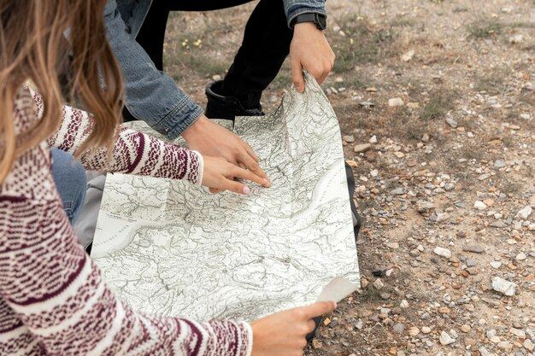
When you are ready……..
…..You will begin your virtual scavenger hunt.

Slide 10
You will be given a series of clues for each of 15 sites
First of all, you will need to figure out the Nebraska County you will be searching.
Site #1
If you were going to list all of Nebraska’s counties in alphabetical order, which county would be the first?

Slide 11
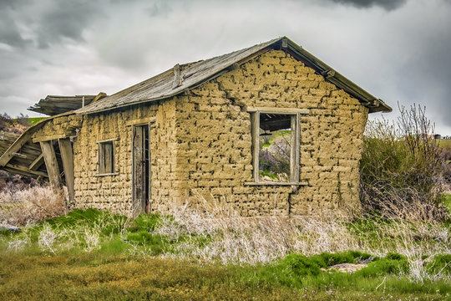
Next, you will be given a clue as to the site itself
Site #1
b) Find a house that was originally built in 1881, not of wood or brick but of something else from the earth. Hint: The nickname for these kinds of structures is “soddies.”

Slide 12
Now fill in all the information requested for the first site on your answer sheet.
 | National Register of Historic Places Scavenger Hunt
Site | ( a ) Name of County | ( b ) Name of Site | ( c ) NR#
1
2
3
4
5
6

Slide 13
Now that you have the hang of it…..
Let the Scavenger Hunt Being!!!

