Slide 1
Meet the Architect!
Michelle McCullough: Project Architect for the Pershing Mural’s Installation Within Historic Wyuka Park

Slide 2
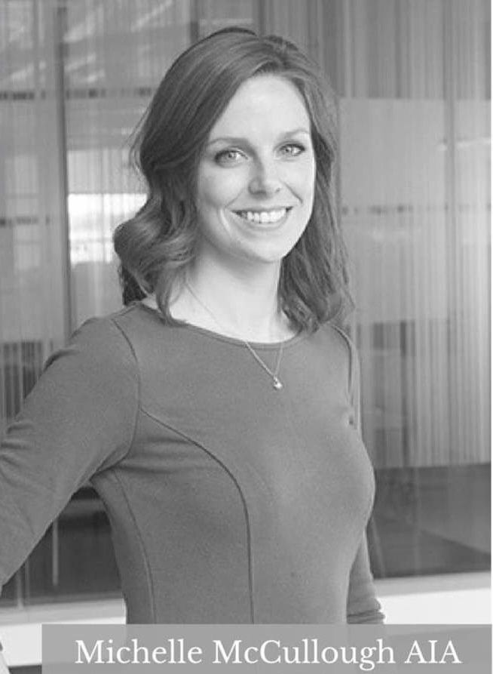
Meet Michelle McCullough, the Project Architect for the Pershing Mural’s Installation:
Bachelor of Arts—Northwestern University
Master of Arts (International Human Rights)—University of Denver—Joseph Korbel School of International Studies
Master of Architecture—University of Nebraska-Lincoln
Owner and Architect—Moment Architecture

Slide 3
Michelle sat down for an interview focusing on her profession as an architect and her commission with the Pershing Mural Project.
Here are her thoughts and insights.

Slide 4
Q: Is Architecture more than designing buildings? If so, in what way?
Architecture is designing Environments.
By that I mean, an architect not only designs the “shell”/the physical building, but the spaces within – their size and relationship to each other, the style/feeling of the building.

Slide 5
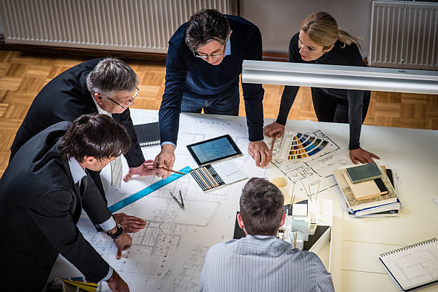
Q: Is Architecture more than designing buildings? If so, in what way?
Architecture encompasses working with clients, understanding their needs, and interpreting that into a physical space.

Slide 6
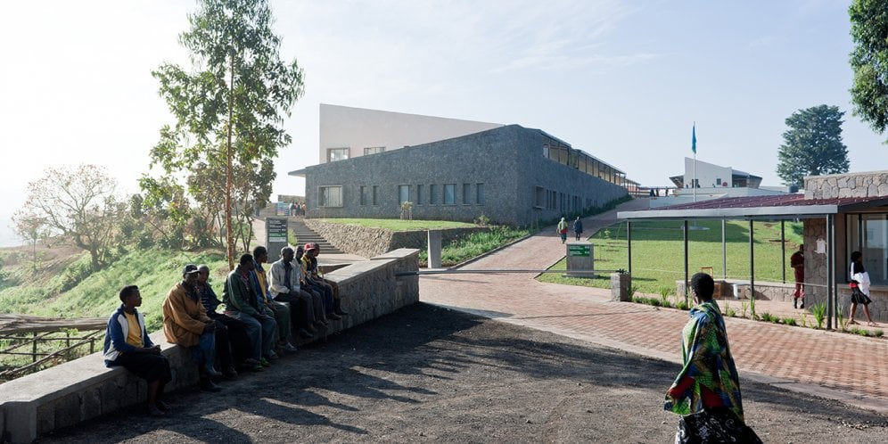
Q: Who is your favorite Architect? Why?
My favorite architecture firm is MASS Design Group.
They are most well known for their hospital designs in Rwanda.

Slide 7
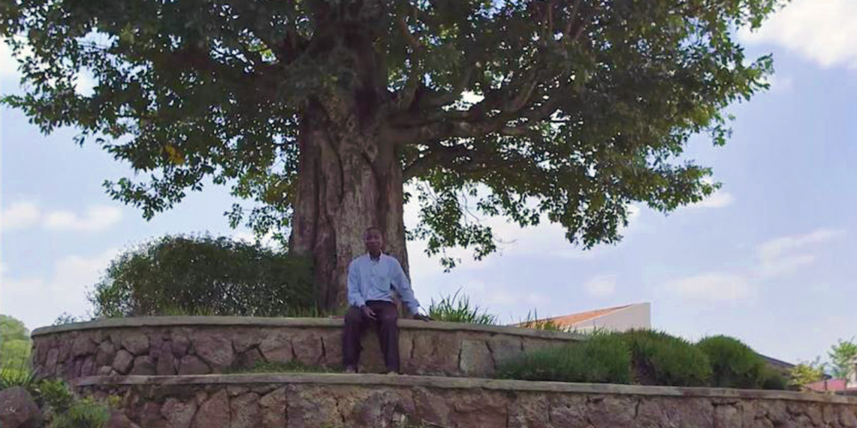
Q: Who is your favorite Architect? Why?
Their focus is on how architecture can make a positive impact beyond just the building.

Slide 8
Q: Who is your favorite Architect? Why?
For their hospital project they used local materials, techniques, and labor to design a space that heals.

Slide 9
Q: Who is your favorite Architect? Why?
For example, instead of designing a hospital where the patient’s beds are facing the room (and other sick people), they chose to face the beds outward towards the windows – this helps patients focus on nature and healing rather than focusing on the sick.

Slide 10
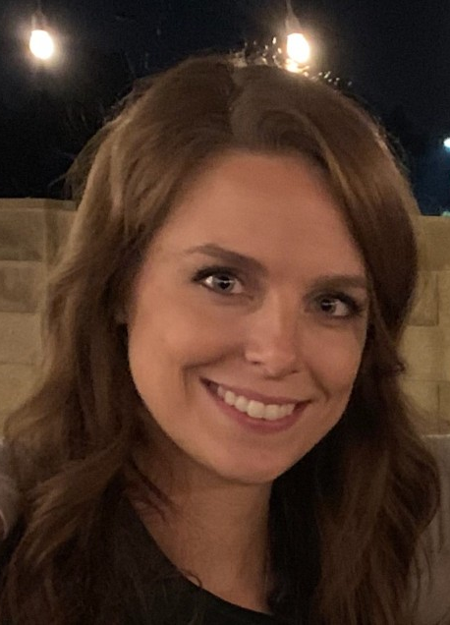
Q: Tell me, Michelle, what are the most important skills an Architect should possess (e.g. communication, creativity, organization, technical skills, vision, etc.)?
The Architect needs to be one of the most well-rounded people.
The profession requires good communication skills to work with various clients and understand their needs.

Slide 11
Q: What are the most important skills an Architect should possess (e.g. communication, creativity, organization, technical skills, vision, etc.)?
The Architect also needs to be creative – to think outside the box and come up with creative solutions to often complex problems.

Slide 12
Q: What are the most important skills an Architect should possess (e.g. communication, creativity, organization, technical skills, vision, etc.)?
And they need to be able to translate their ideas onto the computer to create drawings that can be used for construction.

Slide 13
Q: What is the greatest challenge Architects face today?
I believe the greatest challenge for architects today is expressing the importance and value of well-designed buildings.
Today we see a lot of buildings being driven by developers whose primary goal is to make a profit.

Slide 14
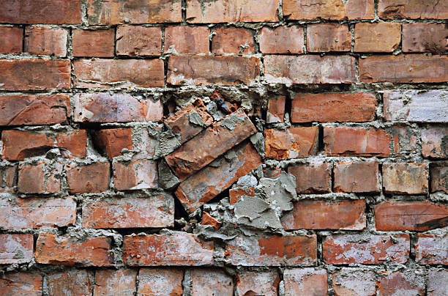
Q: What is the greatest challenge Architects face today?
This leads to buildings that have poorly designed spaces that are built out of low-quality materials.
Unfortunately, this means that many of the buildings we see going up today won’t last nearly as long or function quite as well as those built in the past generations.

Slide 15
Q: What has been your greatest challenge as an Architect?
My greatest challenge is maintaining the passion for each and every project.
Sometimes when there are so many aspects to juggle as an architect it can become overwhelming to maintain the focus of why the project is important and to not get bogged down in the weeds.

Slide 16
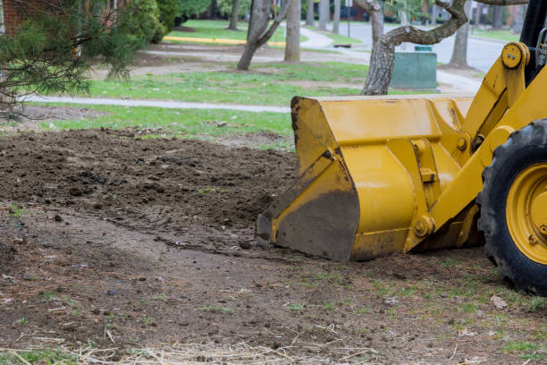
Q: What has been your greatest challenge in regard to the Pershing Mural as the Project's Architect?
The Pershing Mural’s biggest challenge for me is balancing the scale of the project.
Because the mural is so large it has the potential of becoming an obstruction to the neighborhood rather than an asset.
Because of this potential, we have put a lot of thought into how we can use the grading/earth and landscaping to build up behind the mural and make it seem shorter.

Slide 17
Q: How are you working through difficulties encountered because of your role as the Pershing Mural's architect?
I am taking thoughts and ideas from everyone involved in the project.
Because there are many people with different backgrounds and viewpoints on our committee, it helps to hear everyone’s ideas and/or concerns and to take those into account in the design.

Slide 18
Q: Have you worked on any projects like this before?
I have never worked on a project like this before.
All my previous projects have included a building of some sort.
This project is more of an outdoor space with a very large focal point!

Slide 19
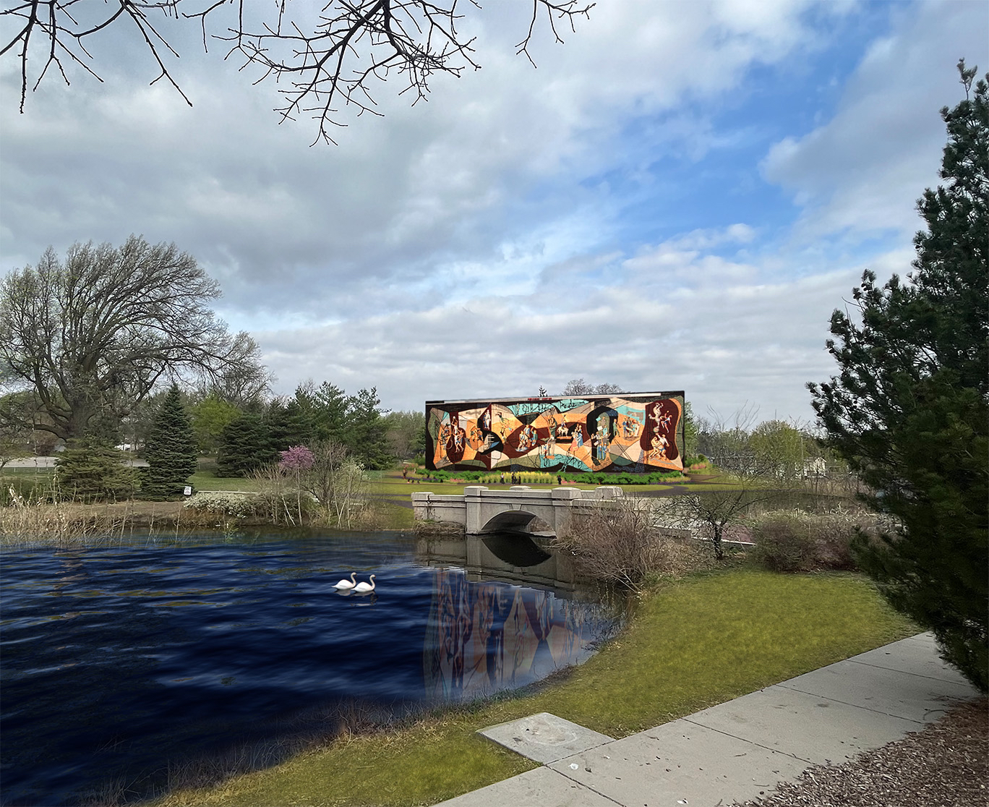
Q: Can you briefly explain your design process involved in reinstalling the Pershing Mural within historic Wyuka Park?
Design always begins with talking to all the people involved – what they see as the goal of the project.
Then we come up with a few different ideas and continue to tailor one idea until it seems to meet all the goals in a way that satisfies everyone involved.

Slide 20
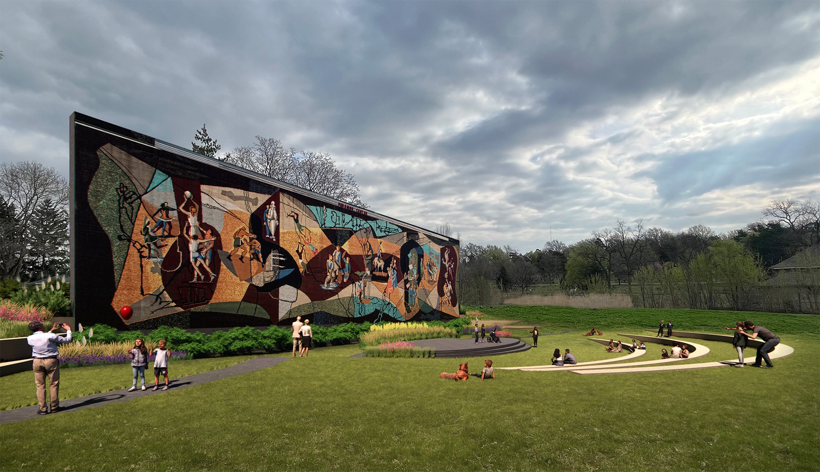
Q: Can you briefly explain your design process involved in reinstalling the Pershing Mural within historic Wyuka Park?
For this project, much of the mural wall design is determined by a structural engineer.
So, my role is to make sure that the aesthetics of the wall are pleasing, and that the surrounding environment is both functional and beautiful.

Slide 21
Q: How are the following elements a part of an Architect's work? Let’s start with Science:
Architects must think about environmental science within their design.
For example, how does the sun affect daylight into a building or what shadows are cast by the building.
We need to think about the force of wind or even the weight of snow on a rooftop.

Slide 22
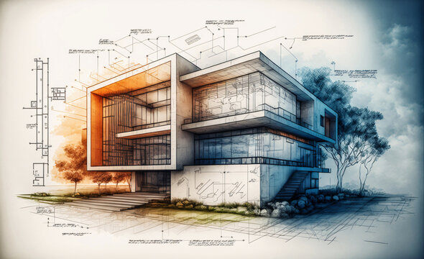
Q: How are the following elements a part of an Architect's work? What about Technology?
Architects today design using technology.
The computer programs we use can show us a design in 3D and can even be walked through like a video game with virtual reality headsets.

Slide 23
Q: How are the following elements a part of an Architect's work? What about Engineering?
Architects need to know the fundamentals of all engineering fields – civil, mechanical, electrical, structural, etc.

Slide 24
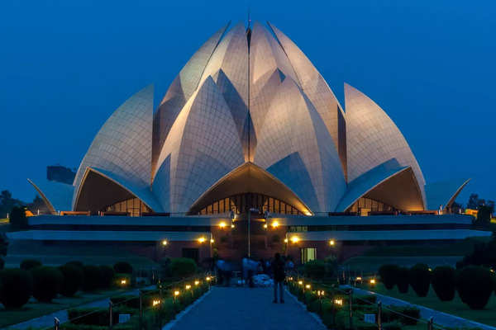
Q: How are the following elements a part of an Architect's work? What about Art?
Architecture requires a design eye.
By that I mean, a well-designed building does not only function well, but also has “form.”
The aesthetics (looks and feel) of a space hugely affect how people experience it.

Slide 25
Q: How are the following elements a part of an Architect's work? What about Mathematics?
Architecture requires the use of mathematics in multiple aspects.
For each project an architect will calculate the number of people a building can hold, the slopes of a ramp that a wheelchair can handle, etc.

Slide 26
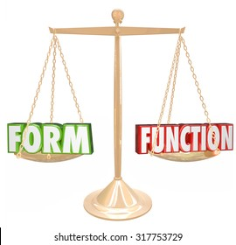
Q: I'm wondering if your thoughts related to the question, "Is Architecture a Science or an Art?”
Architecture is both! We often refer to this as “Form versus Function.”
There is a delicate balance for the architect of creating a space that “functions” – it meets code guidelines, it’s structurally sound, etc. – and creating “form” – it is aesthetically pleasing, the design fits within the surroundings, etc.

Slide 27
Q: How many years does it usually take to get your degree in Architecture?
The typical architecture degree takes 6 years – 4 years of undergrad and 2 years of Masters.
After that, there are a required number of hours and a series of exams that you must take to become a “licensed” architect.

Slide 28
Q: How do you charge for your work?
This depends on the project.
Sometimes an architect will determine the estimated cost of a project and charge a percentage-based fee from that.

Slide 29
Q: How do you charge for your work?
For example, if a project cost is $100,000 the architect may say their fee is 5% of that cost – so their fee would be $5,000.
Other projects may be charged for “Time & Materials” this means that the architect determines their hourly rate and only charges for time they work on a project.

Slide 30
Q: What do you love most about being an Architect?
My favorite part about being an architect is always learning something new!
Sometimes you may work on a hospital project and learn all the little details of being a doctor (how many drawers do they need in their desk?) or being a patient (which direction should the window face to get the most sunlight to the hospital bed?).

Slide 31
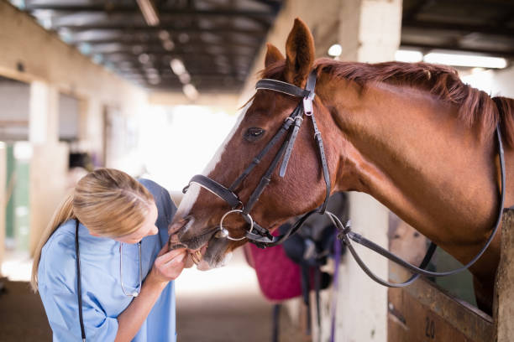
Q: What do you love most about being an Architect?
Then the next project may be for a veterinary clinic, and you need to learn all about how large a room needs to be for a horse to fit!

Slide 32
Q: In your opinion, what are an Architect's greatest challenges?
An Architect’s greatest challenge is being the jack of all trades.

Slide 33
Q: In your opinion, what are an Architect's greatest challenges?
The umbrella of the architect spans very wide – from detailed engineering to people-skills – the architect needs to be proficient in as many areas as possible to be successful.
So, this ends up being the most fun part as well as the most challenging!

Slide 34
Special thanks to Michelle McCullough….
The Pershing Mural Architect!!

