Slide 1
General John J. Pershing
The General of Armies

Slide 2
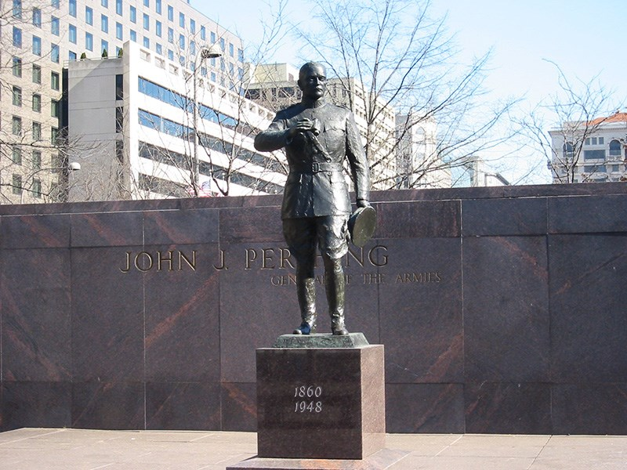
“His name must be known by all Americans—every veteran, every school child. We are the generation that will ensure his name is firmly planted in the hearts, minds, and history of our country. The Pershing name must not be lost to history.”—Dwight Eisenhower
“His name must be known by all Americans—every veteran, every school child. We are the generation that will ensure his name is firmly planted in the hearts, minds, and history of our country. The Pershing name must not be lost to history.”—Dwight Eisenhower
Pershing Park on Pennsylvania Avenue NW, Washington, DC.

Slide 3
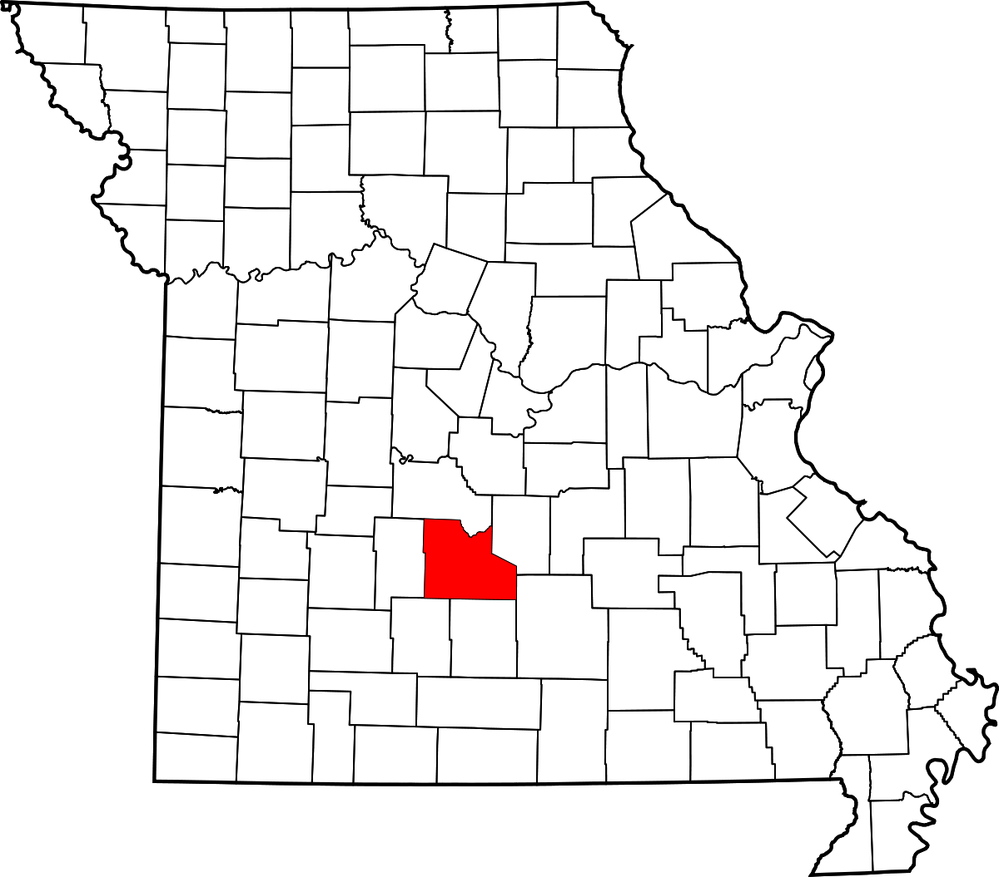
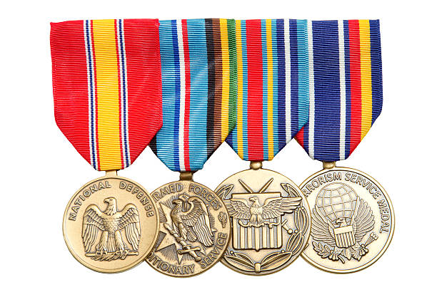
John J. Pershing (1860-1948) was born into humble beginnings in Laclede, Missouri.
Through his decorated military career, Pershing became General of Armies (a rank created specifically for him), which made him the highest-ranking living active-duty officer in American military history.

Slide 4
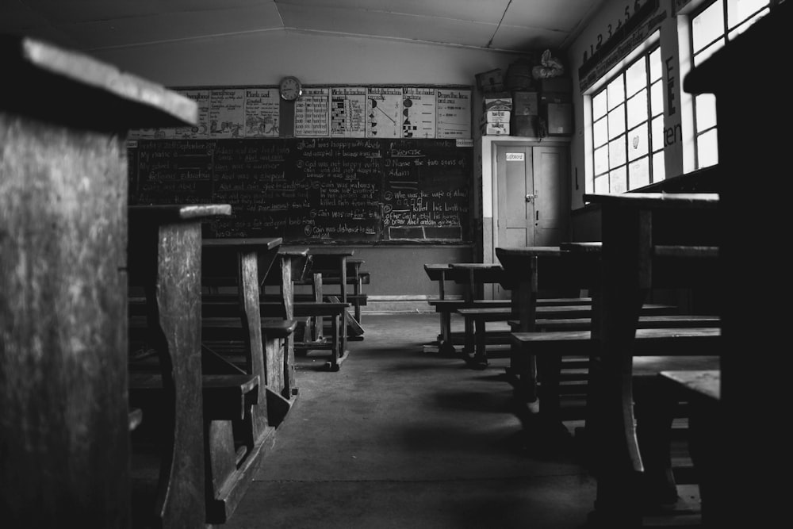
When Pershing was still in his teens, his first job was as a school teacher at Prairie Mount School in Chariton County, Missouri where he taught black students.

Slide 5
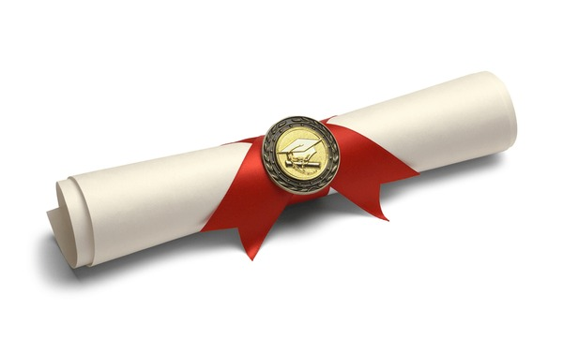
By saving money from his teaching job, he was able to attend school in the summer months and Pershing received his A.B. Degree from Kirkville Normal School in Northern Missouri.

Slide 6
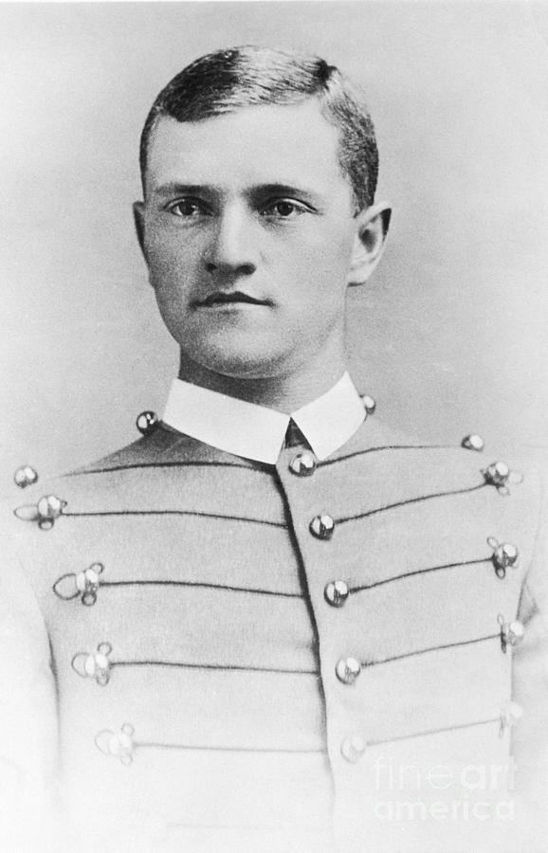
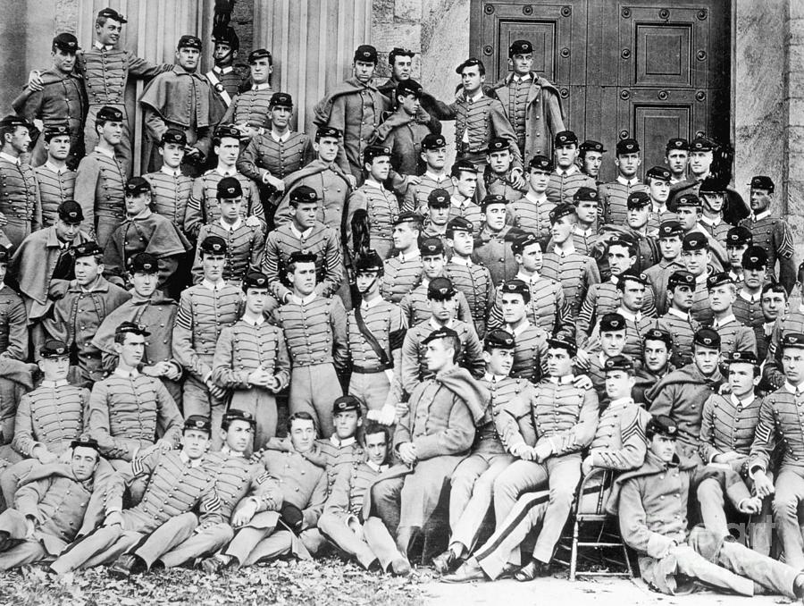
When Pershing saw an ad for West Point, seeking “honest, strong-God-fearing boys,” he applied and passed his entrance exam, joining the Academy in 1882.
He graduated in 1886, 30th in a class of 77.

Slide 7
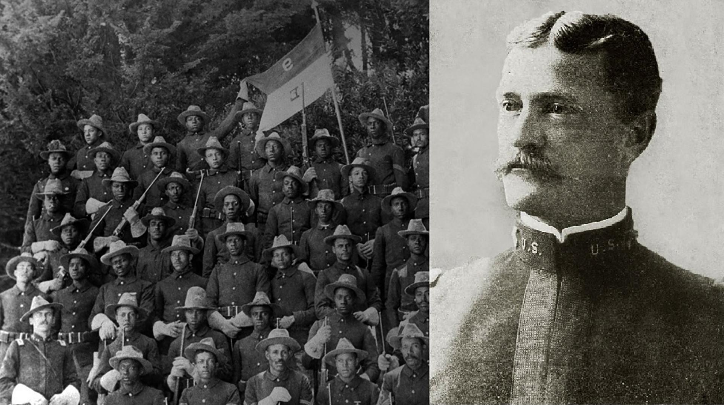
His first post after graduating the Academy was at Fort Bayard, New Mexico where he became a First Lieutenant commanding a unit of black calvary, the buffalo soldiers.

Slide 8
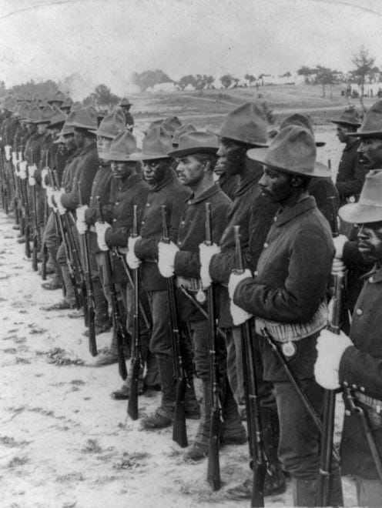
American Plains Indians who fought against these soldiers referred to the black cavalry troops as "buffalo soldiers" because of their dark, curly hair, which resembled a buffalo's coat and because of their fierce nature of fighting.
Pershing’s nickname was “Black Jack” Pershing. One theory for the origin of the name is that it came from commanding the Buffalo Soldiers.

Slide 9
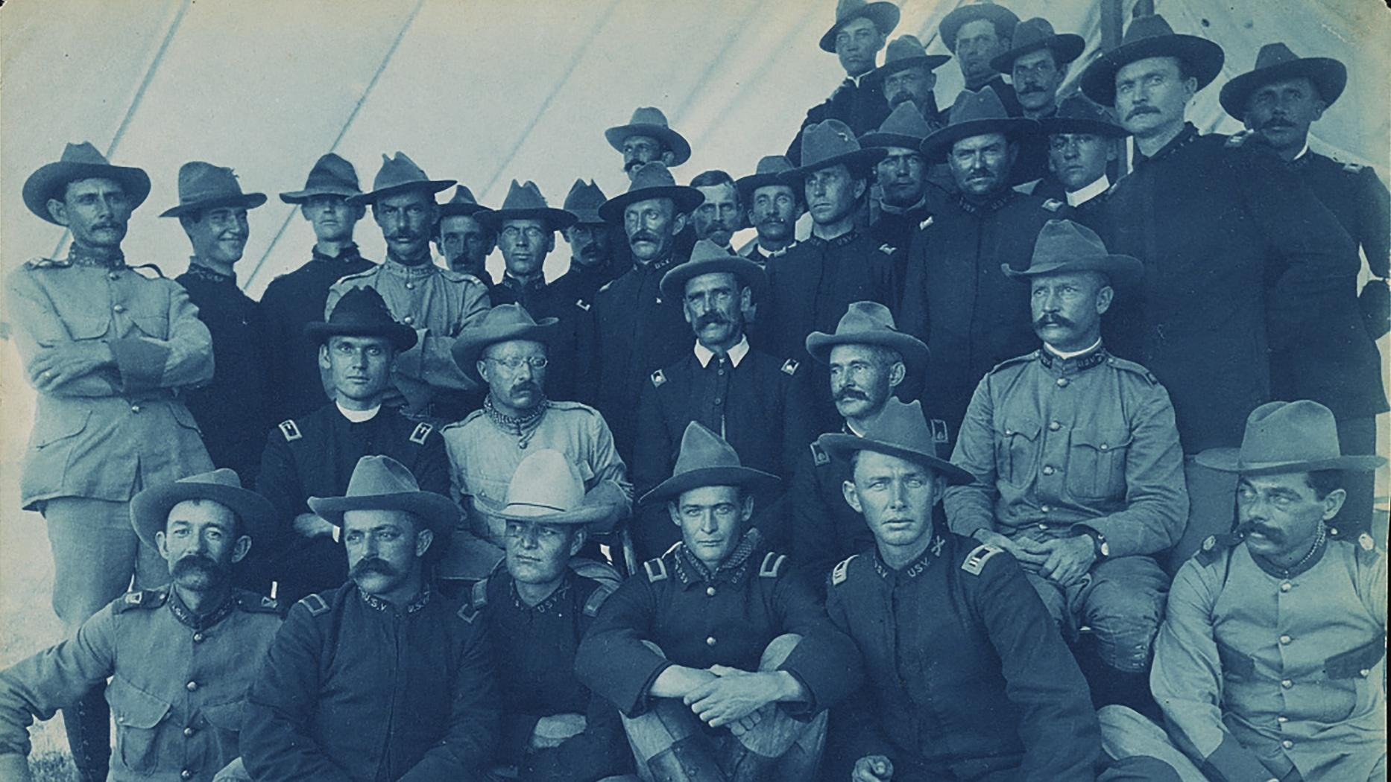
During the 1898 Spanish American War, he fought alongside Theodore Roosevelt and his “Rough Riders.”

Slide 10
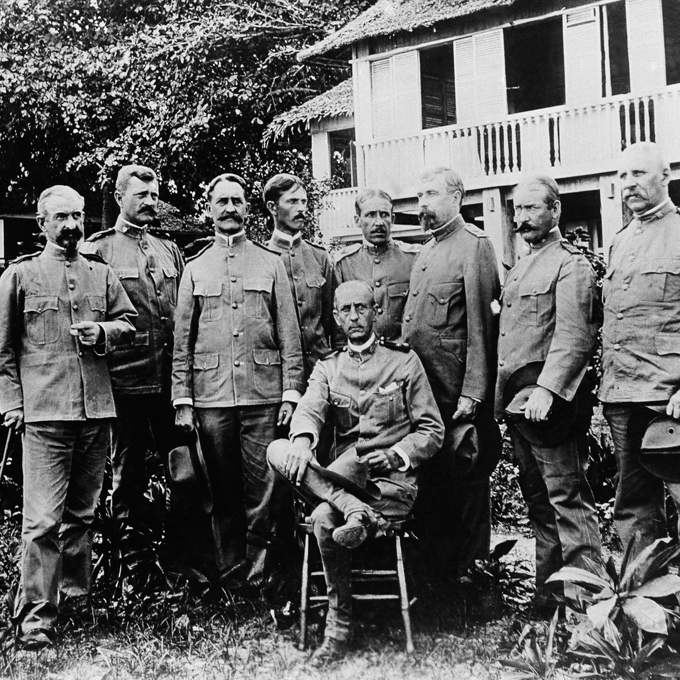
Pershing earned the Silver Star for this service and was promoted to the rank of Captain.
For much of the early 1900’s, Pershing served in the Philippines where he commanded US troops and was the military governor of the southern Philippines.
Pershing is second from the left

Slide 11
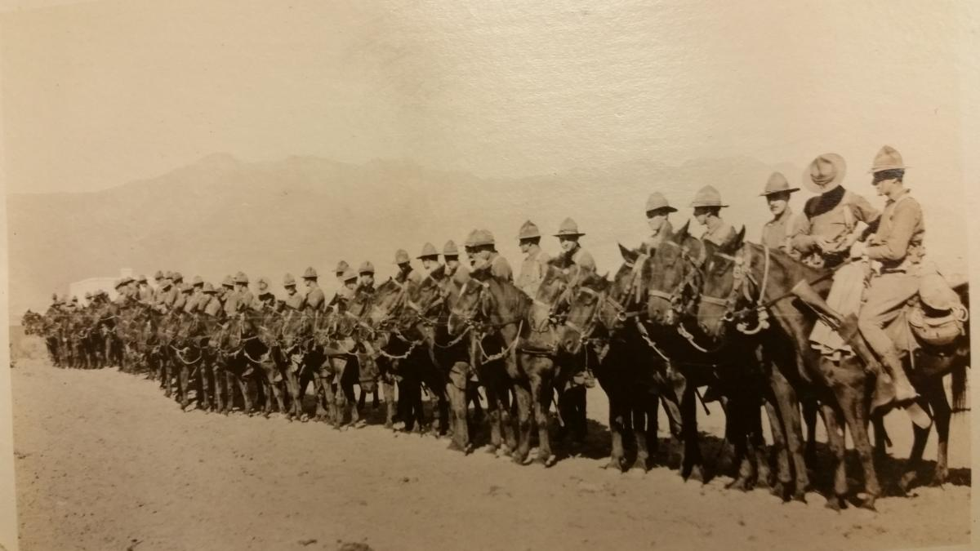
In 1904, President Theodore Roosevelt appointment him as a brigadier general ahead of 862 other officers who had more seniority.
In 1914 Pershing was sent to the Mexican border where he was charged with squashing attacks on Americans.

Slide 12
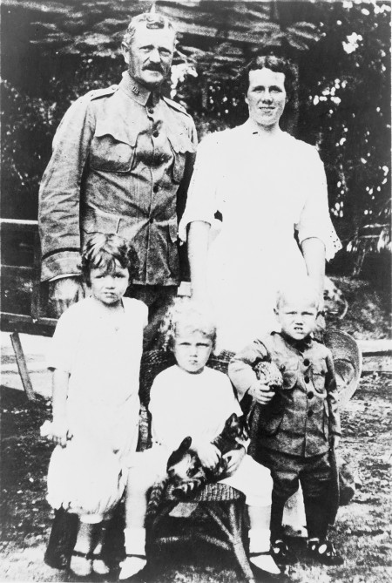
In late August 1915, while Pershing was stationed away from his family, a house fire claimed the lives of his wife Frances and his three daughters. His young son Warren survived, but Pershing's loss was profound.

Slide 13
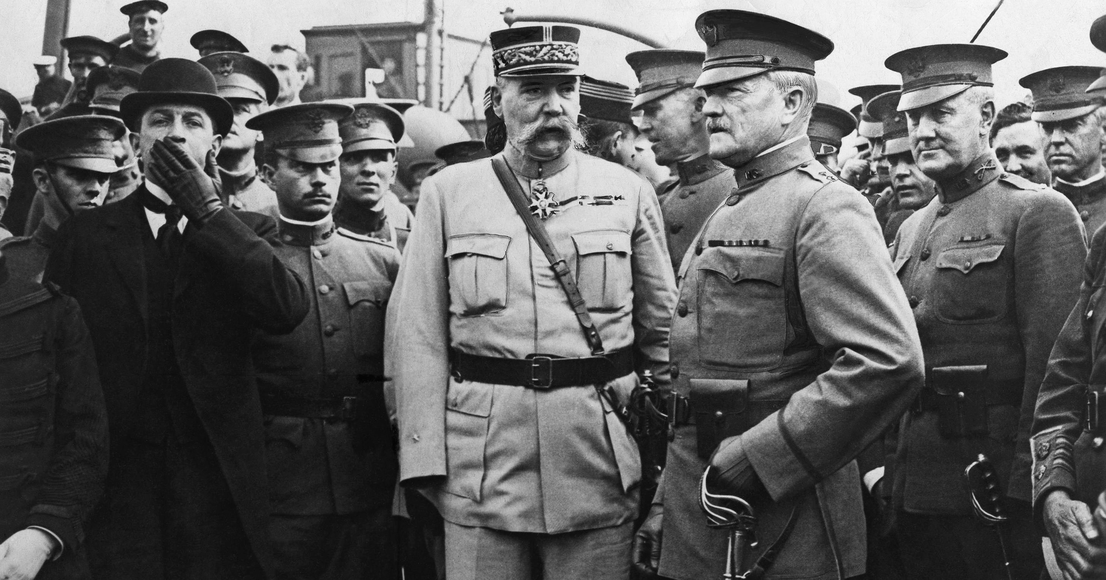
In April, 1917, with the entrance of the U.S. into World War I, Pershing was promoted to a Major General and became the commander of the AEF (American Expeditionary Forces).

Slide 14
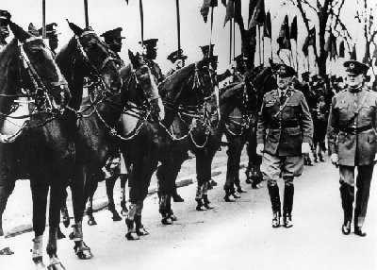
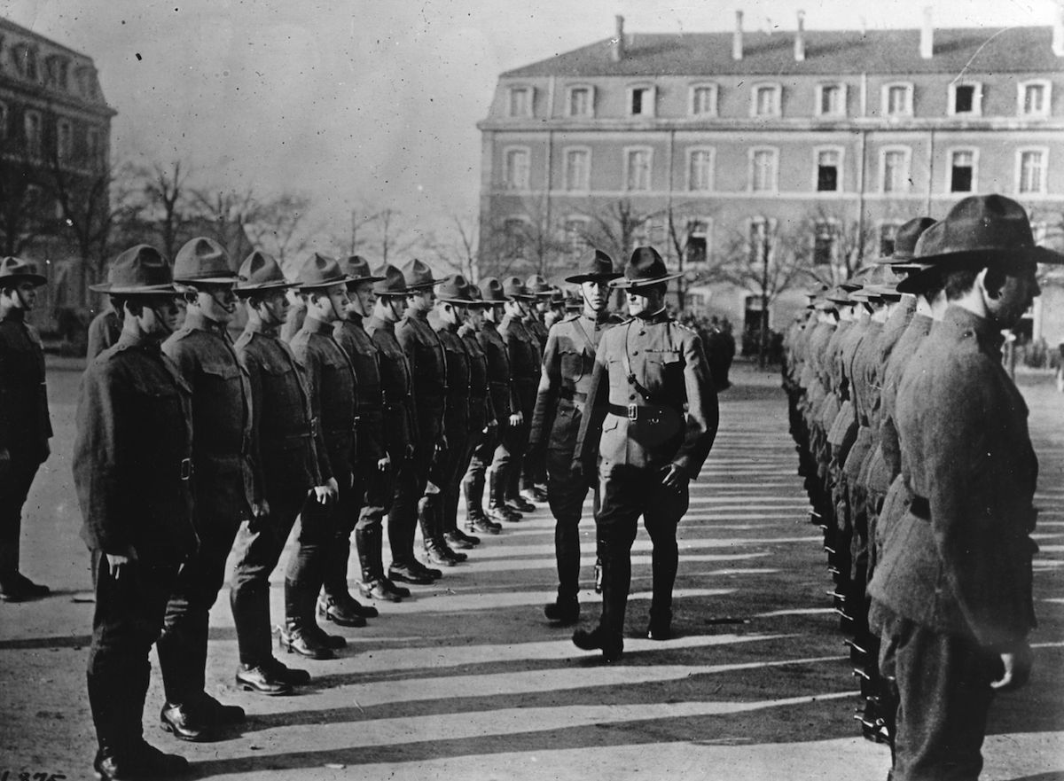
It was Pershing’s task to build and prepare the small and inexperienced U.S. peace-time military (220,000 soldiers and officers) for war.

Slide 15
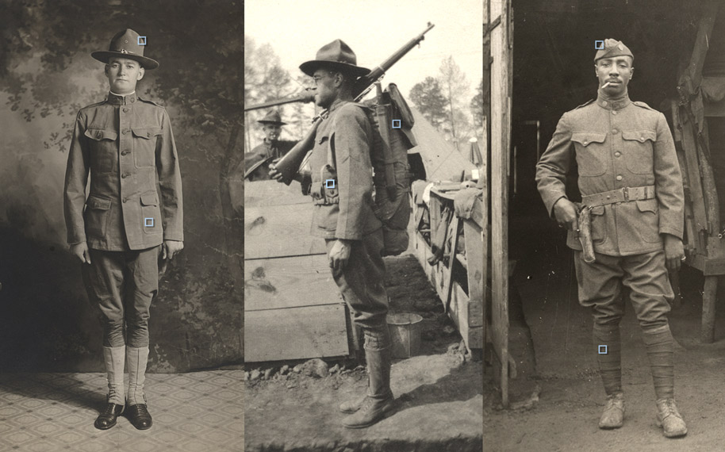
Within 18 months, Pershing helped train and transform the troops which grew to more than two million “doughboys”.

Slide 16
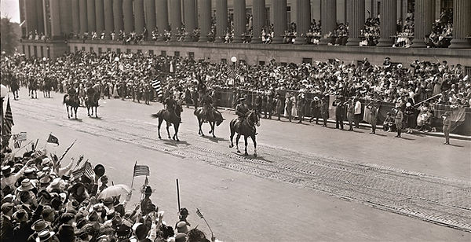
By mid-1918, the German government was faced with 2 million American soldiers among the allied ranks under the command of General Pershing with 2 million more on the way. Germany surrendered on November 11, 1918, and the war was ended.
General Pershing leading the Victory Parade 1918

Slide 17
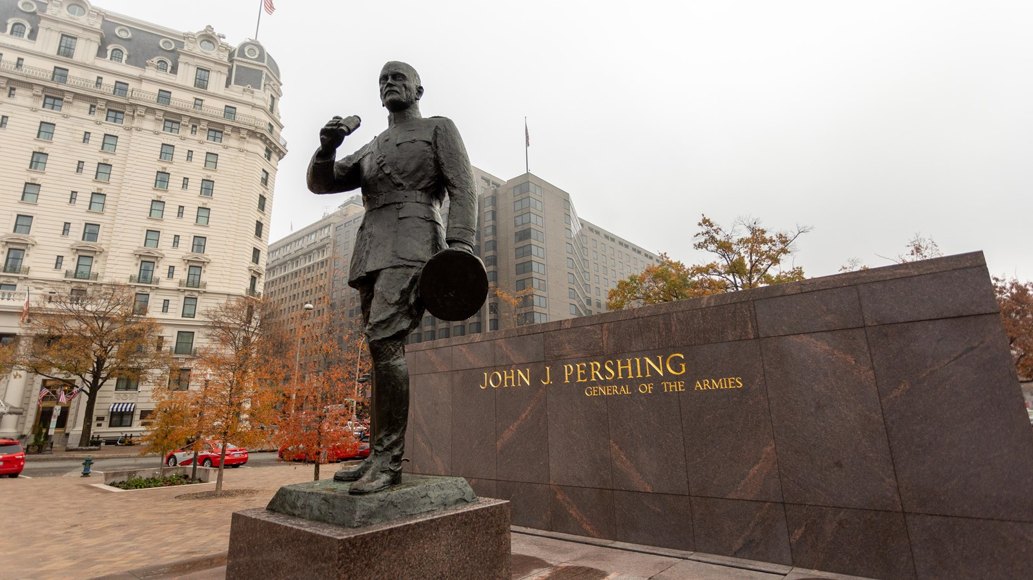
After WWI in 1919, President Woodrow Wilson promoted Pershing to General of the Armies, the highest-ranking military office in history.

Slide 18
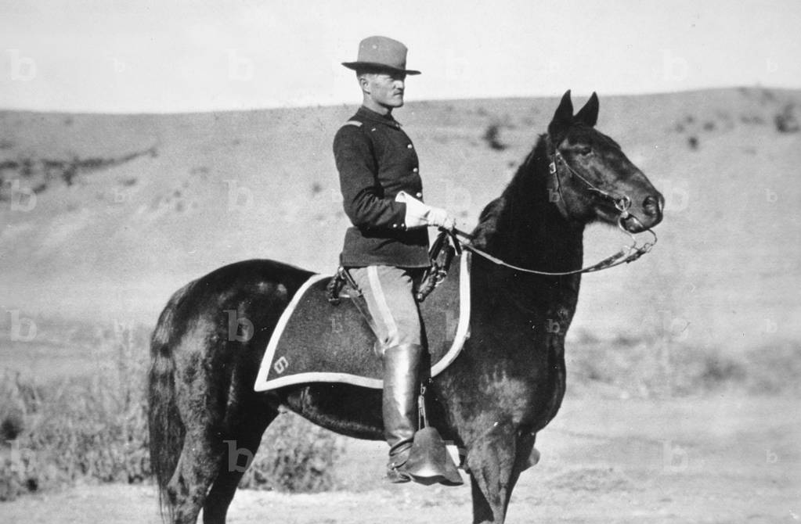
John J. Pershing’s Nebraska Connection
As a young lieutenant in 1887, Pershing served in New Mexico in the U.S. Army’s 6th Calvary, trying to keep the peace between settlers and Native tribes who resided there.
After five years on the American frontier, he was disheartened by the circumstances facing the Native Americans and felt sympathy for them because of their mistreatment.

Slide 19
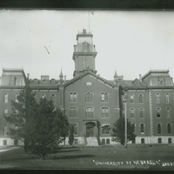
At a time of national peace and with much to mull over, Pershing was reexamining his military career prospects when, in 1891, he was assigned to the University of Nebraska.

Slide 20
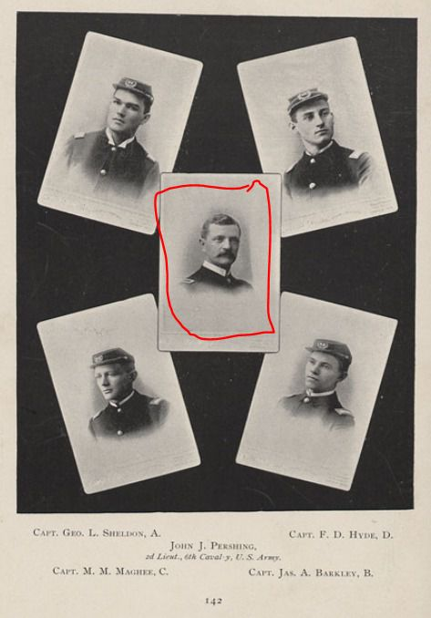
His commission was to lead the cadet training program and teach classes in math and military tactics.
This gave him the perfect opportunity to take time to re-evaluate his career path and even pursue his studies in Law.

Slide 21
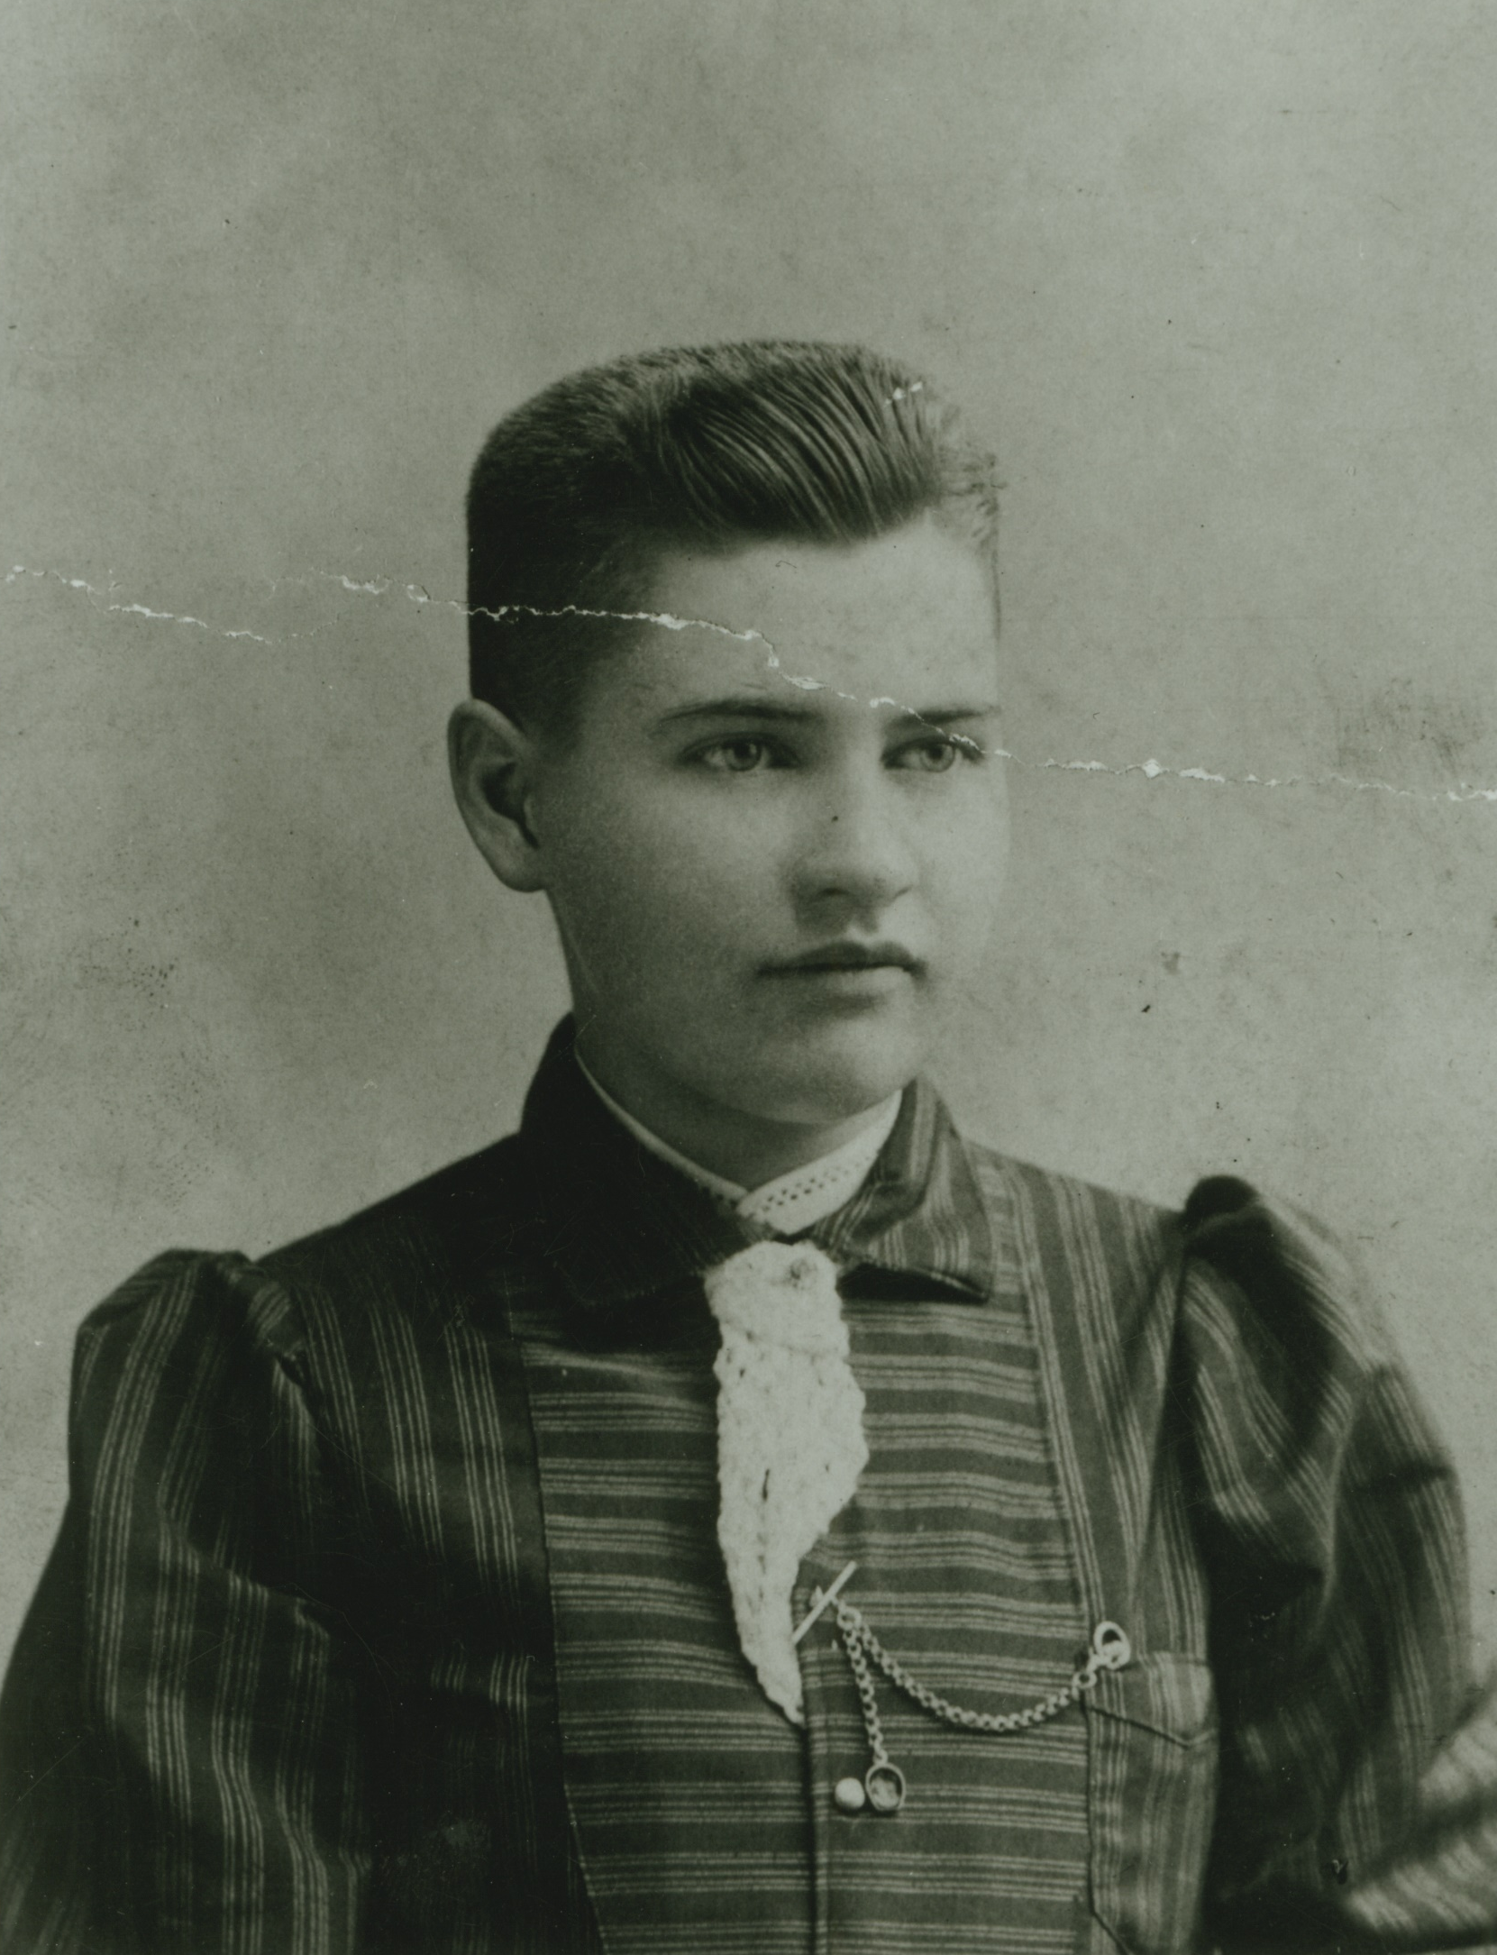
While earning his law degree, Pershing taught math class at the University of Nebraska every school day for three hours.
Among his students were future authors Willa Cather and Dorothy Canfield.

Slide 22
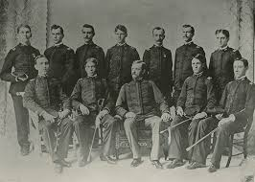
As head of the Cadet Training Program, it was Pershing’s task to whip the cadets in the training program into shape.
When Pershing took over, he found just 90 lackluster students who did not take the training seriously.

Slide 23
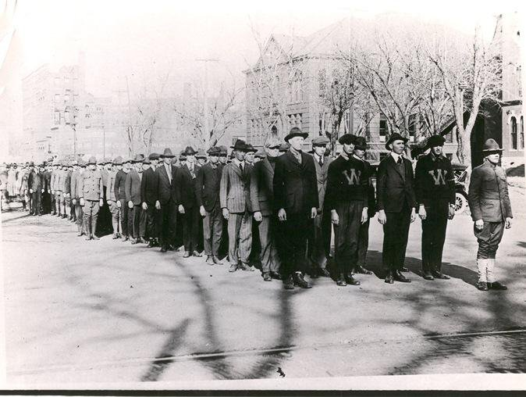
Pershing was able to win over the cadets by instilling discipline and pride in the corps.

Slide 24
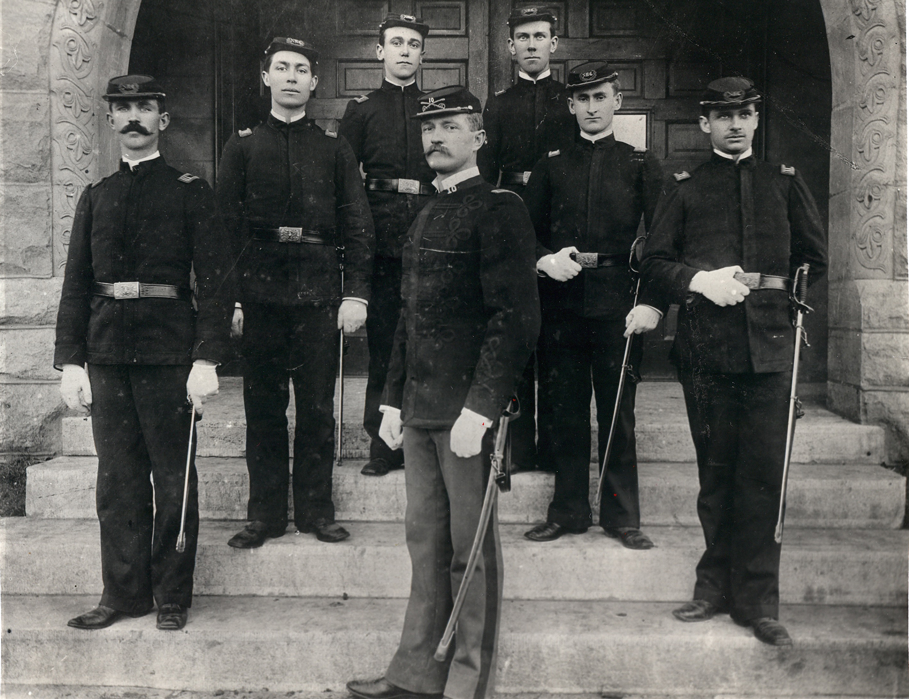
Within a year, the university cadet corps swelled to 350 students and pride for the program grew at the school.

Slide 25
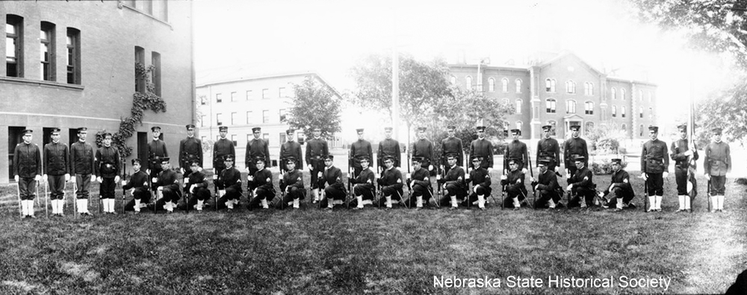
In 1892, a national military drill competition was held in Omaha and through discipline, pride and hard work, Pershing’s Cadets took top honors in their division.

Slide 26
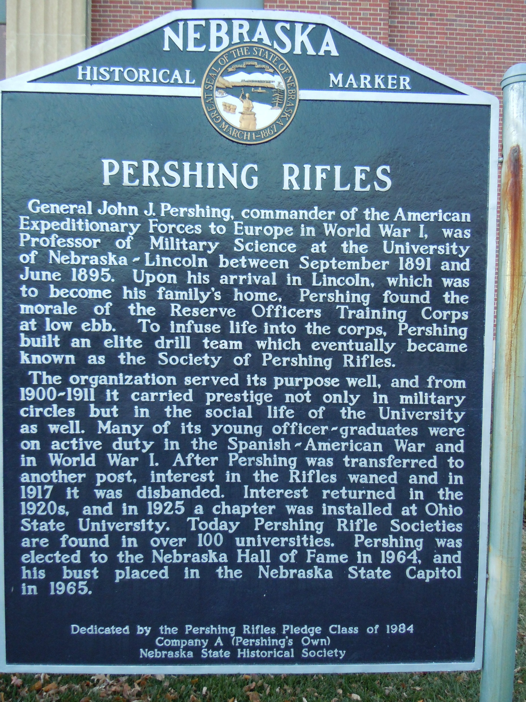
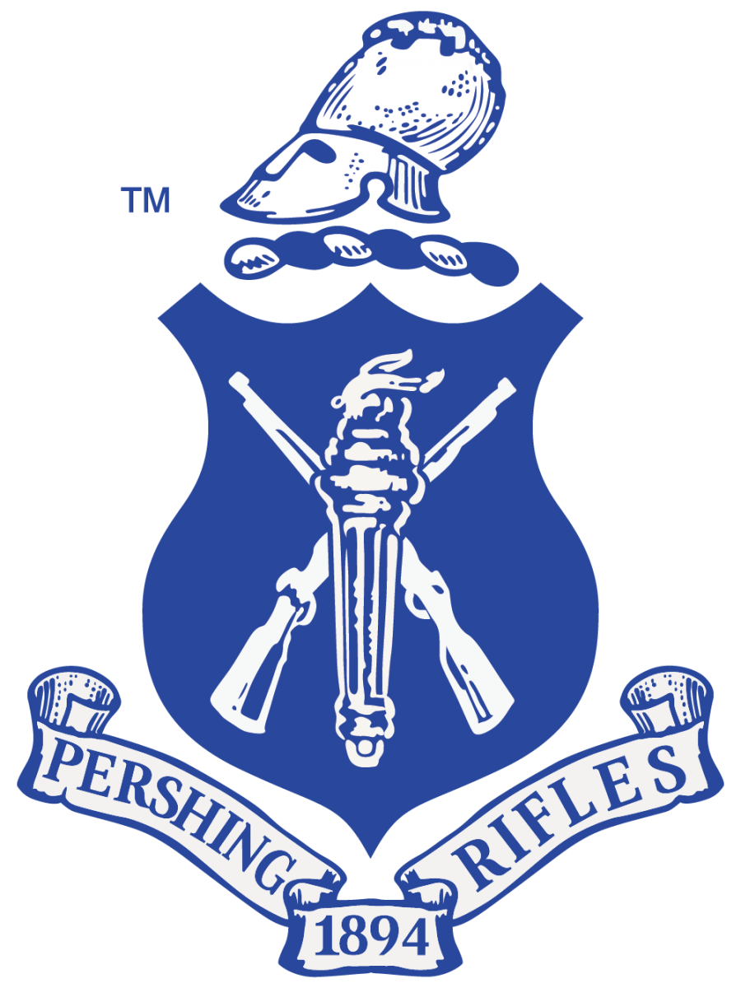
Years later, in honor of their former cadet corps commander, the University of Nebraska military drill team renamed itself “Pershing’s Rifles” and units of its kind still flourish across the country as a lasting tribute to Pershing’s legacy.

Slide 27
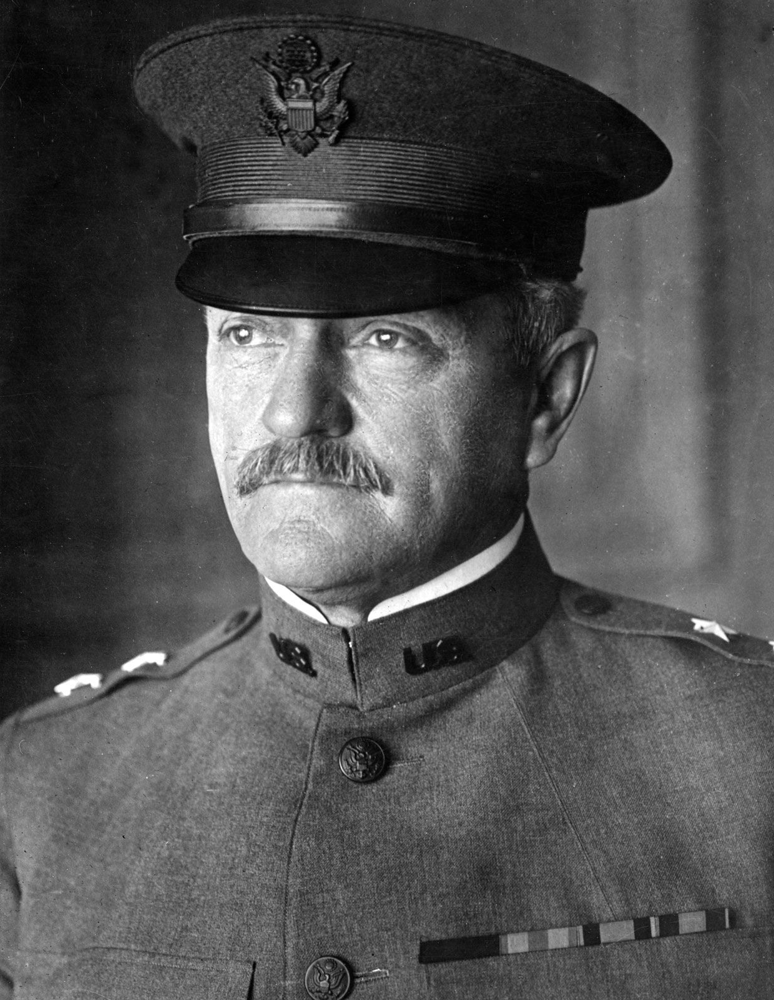
By 1895, Pershing finished his studies, received his law degree, and recommitted himself to the military, going on to build his historic career through his service to his country.
Despite his rise in fame, accomplishments, and stature, his friendships and bonds with the Lincoln community would last.

Slide 28
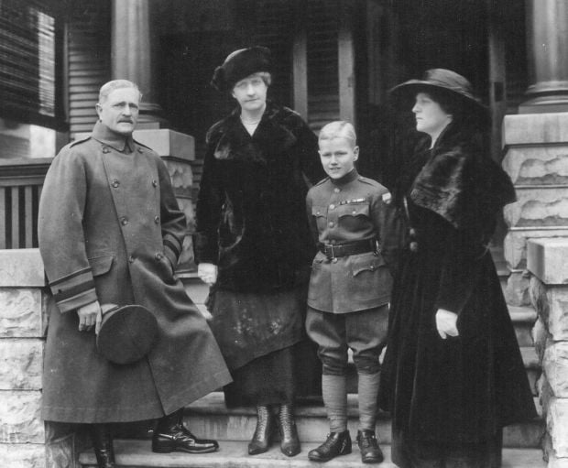
Pershing’s 7-year-old son, Warren, stayed with his aunts in Lincoln, Nebraska while his father commanded the troops in WWI.
He would call Lincoln his second home and would frequently return to Lincoln when his duties from around the nation allowed, visiting his sisters in a home Pershing owned on 17th and B Streets.

Slide 29
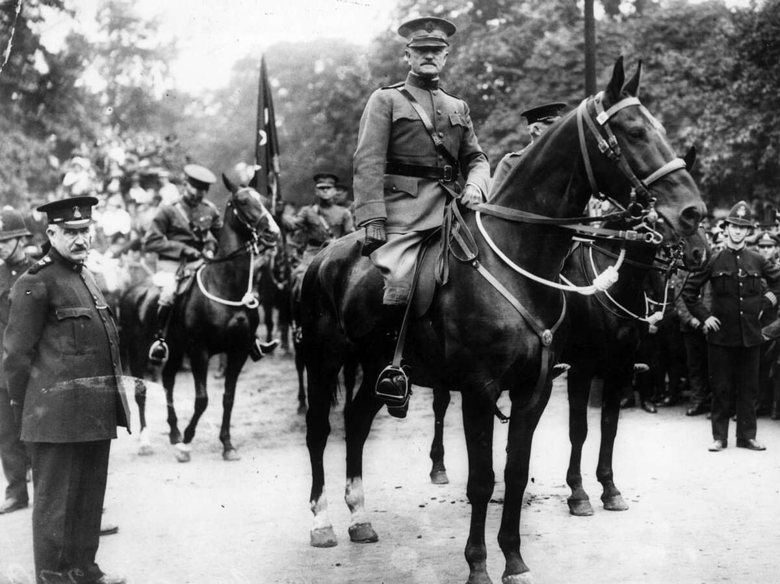
Even though General John J. Pershing may not be a common name to this generation in the 21st century, there is still much that can be learned from his life and legacy.
Much of his fame rests on his personal character, his will for victory, and his belief in his military.

Slide 30
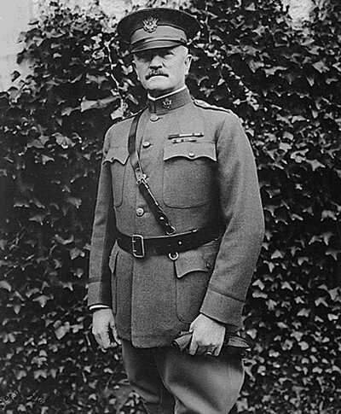
Times may change, but the tough determination, hard work, discipline, and character it takes to be successful have not.

