Slide 1
Conducting an Oral History Interview
Preserving Memories, Perspectives and Voices of People in History

Slide 2
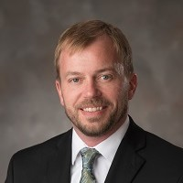
Meet Dr. Patrick Jones
Associate Professor of History and Ethnic Studies at the University of Nebraska-Lincoln
And Humanities Scholar for Humanities Nebraska who has consulted on and contributed to the Pershing Mural Curriculum.

Slide 3
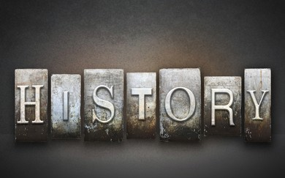
As an historian, professor and scholar, Dr. Jones has conducted many oral history interviews in his studies and work.
But what is oral history and why is it significant?

Slide 4
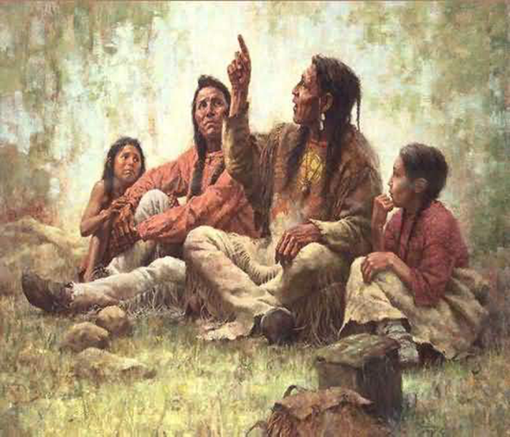
Oral History…..
• is critical in collecting stories from
participants in the past
• literally brings history to life
• reminds us that people are what history is
really all about
• is particularly important for “hidden
histories”
• creates a new historical artifact
“story-teller”

Slide 5
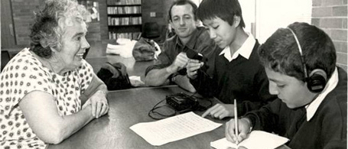
And oral history interviews are an important part of capturing and preserving our history by speaking with those who have actually lived it.
But how do you actually conduct an oral history interview?

Slide 6
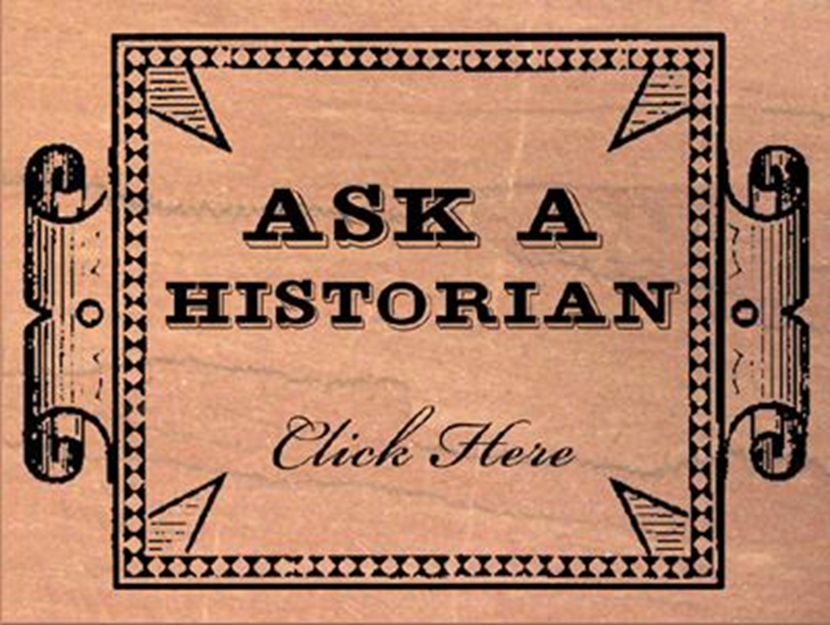
Let’s ask the expert!
“Hey, Patrick!
Do you have any tips for us about doing oral history interview(s)?”

Slide 7
“Sure thing! Before your interview:”
• contact your interview subject
• learn as much as you can about your subject
• formulate 5-10 questions
• prepare permission for your interviewee
• create a division of labor if you
are working with a partner(s)
• practice!

Slide 8
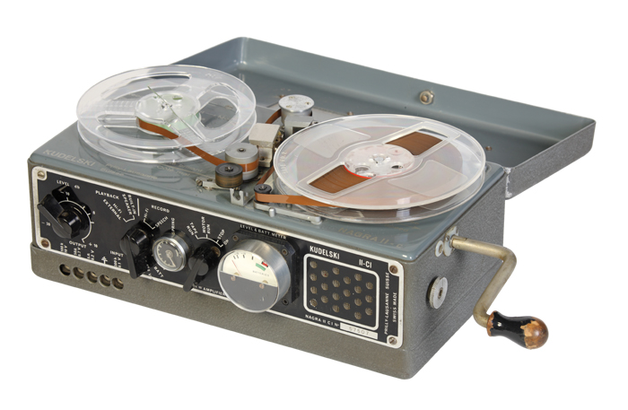
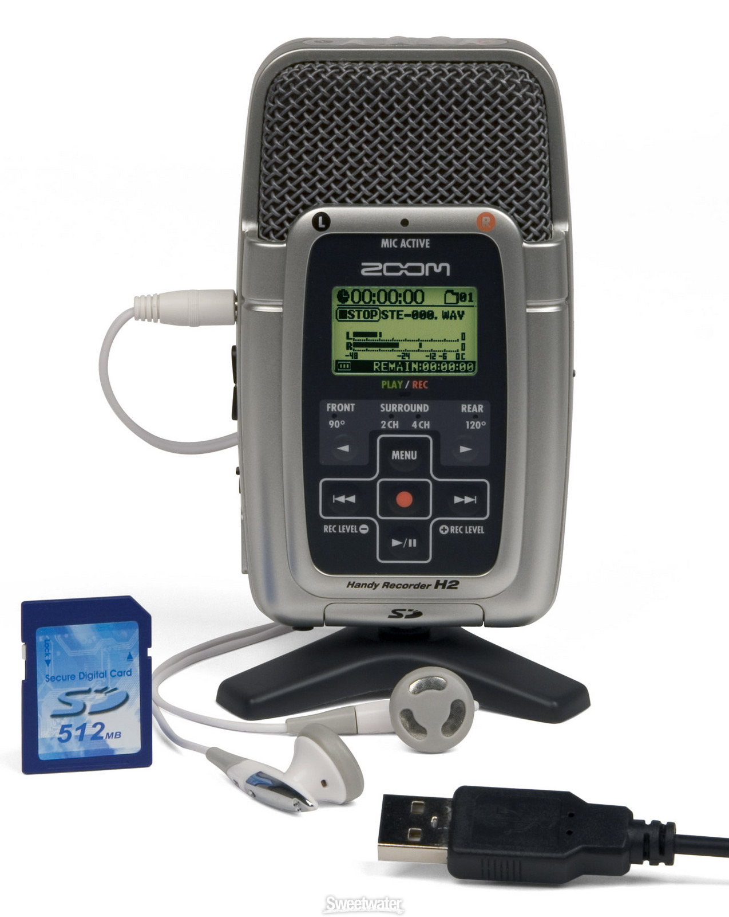
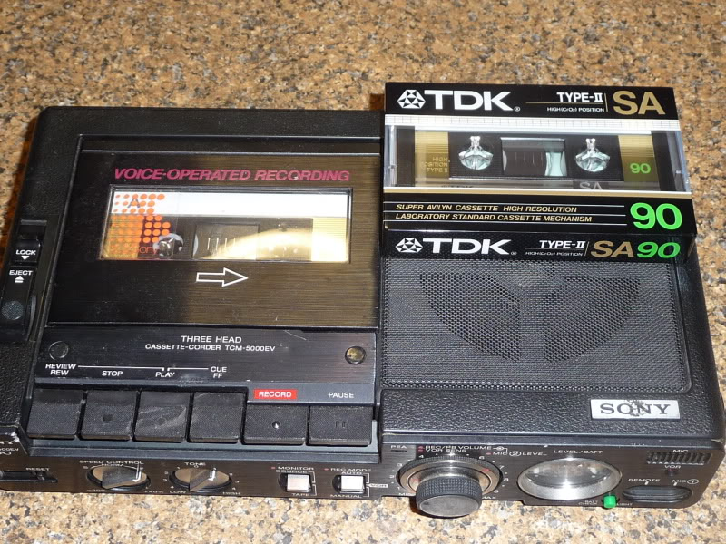
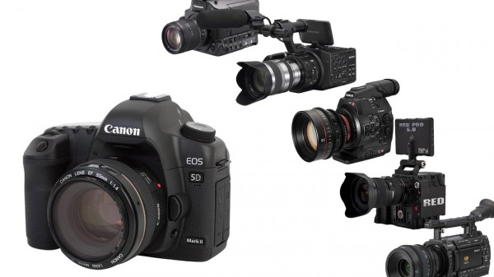
“Be sure to check the “tech” you will be using during your interview…
technology has come a long way!”

Slide 9
“The day of your interview:”
• contact your interview subject
• learn as much as you can about your subject
• formulate 5-10 questions
• prepare permission for your interviewee
• create a division of labor if you
are working with a partner(s)
• practice!

Slide 10
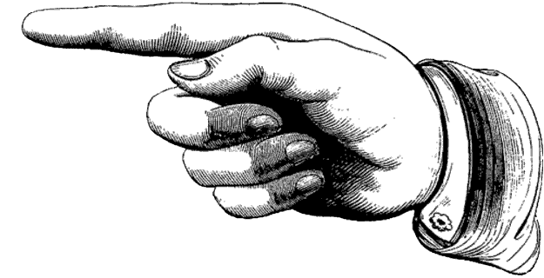
“Here are a few “go-to” phrases
when doing an oral history interview…”
• “That is very interesting, can you say more about that?”
• “Can you think of a specific story, or example, that illustrates your
point?”
• “What did you think of that? How did it make you feel?”
• “What do you think I should know that we have not yet talked
about?”
• “Is there anyone else you think we should talk to about this
topic?”
• “Do you have any historical artifacts related to this history that
you might be willing to share with us?”

Slide 11
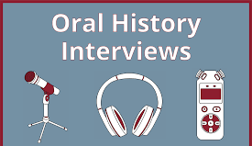
“After your interview:”
• send a thank-you
• talk about what you each
heard in the interview
• re-listen and select
• edit with iMovie
• reflect in your journal about your experience doing oral history!

Slide 12
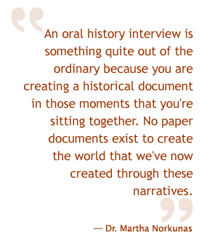
“What you are doing is important!”

Slide 13
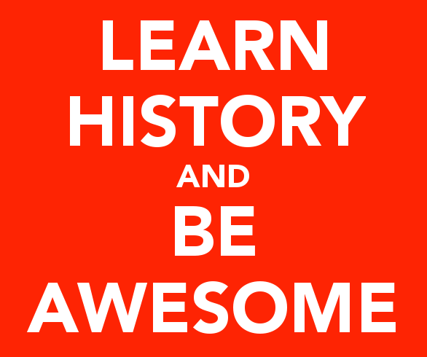
“And remember, the goal in everything
you are doing is…”

